Slide 1



Sarl national technical symposium 2026
In association with AMSAT SA
Development of a contesting and dxing dashboard for the hamsci personal space weather station
Owen Ruzanski KD3ALD

Slide 2

Who am i?
From Shohola, PA, USA
Graduated High School in 2024
Started at the University of Scranton studying Computer Engineering
Licensed in January of 2025
Started development of the dashboard soon after being licensed

Slide 3
What is hamsci?
HamSCI stands for Ham Radio Citizen Science Investigation
Citizen science initiative connecting amateur radio to space physics research
Advances scientific research through amateur radio activities
Develops new technologies to support that research
Provides educational opportunities for amateurs and the general public
Community ranges from backyard hobbyists to professional scientists
https://www.hamsci.org
Notes:
HamSCI is a citizen science initiative that advances space physics research through the amateur radio community. Its three core missions are advancing scientific research and understanding through amateur radio activities, encouraging the development of new technologies to support that research, and providing educational opportunities for the amateur community and the general public. HamSCI brings together a wide range of participants — from backyard hobbyists to university researchers and professional space scientists — making it a truly collaborative, community-driven effort.

Slide 4
Who’s behind hamsci?
Led by the University of Scranton Department of Physics and Engineering
Collaborators: Case Western Reserve, U of Alabama, NJIT, MIT Haystack Observatory, TAPR
Funded by the NSF, NASA, and ARDC
Supported by volunteer members of the amateur radio community
Notes:
HamSCI is led by the University of Scranton Department of Physics and Engineering, in collaboration with Case Western Reserve University, the University of Alabama, the New Jersey Institute of Technology Center for Solar Terrestrial Research, and the MIT Haystack Observatory. Additional support comes from TAPR and volunteer members of the amateur radio community. Funding is provided by the National Science Foundation, NASA, and Amateur Radio Digital Communications (ARDC).

Slide 5
Why Amateur Radio for Space Science?
The ionosphere affects how radio waves travel
Solar events (flares, geomagnetic storms) visibly disrupt amateur radio signals
HamSCI turns everyday operator observations into structured scientific data
Key research questions:
  How does the ionosphere respond to space weather inputs?
  What causes traveling ionospheric disturbances and Sporadic E?
  How do solar events affect radio propagation?
Notes:
The ionosphere — the electrically charged layer of Earth's upper atmosphere — directly affects how radio waves travel. Amateur radio operators have long noticed that solar events like flares and geomagnetic storms can disrupt or enhance their signals. HamSCI turns those everyday observations into structured, reproducible scientific data, asking questions like: How does the ionosphere respond to inputs from space and the neutral atmosphere? What causes traveling ionospheric disturbances and Sporadic E? How do space weather events affect radio wave propagation?

Slide 6
What is a personal space weather station?
HamSCI's flagship distributed instrument network
Low cost ($100–$1,000), deployable by citizen scientists and educators
Individual station data aggregated into a central research database
Instruments include GRAPE Doppler Monitors, WSPR receivers, and ground magnetometers
Notes:
The PSWS is HamSCI's flagship instrument network — a geographically distributed, multi-instrument system for making ground-based measurements of the space environment. Designed to be low cost ($100–$1,000) and deployable by citizen scientists, educators, and researchers. Data from individual stations is aggregated into a central database for broader space science research. Instruments include GRAPE WWV Doppler Monitors, WSPR receivers, and ground magnetometers. Led by the University of Scranton in partnership with TAPR, CWRU, UA, NJIT, and MIT Haystack Observatory.

Slide 7
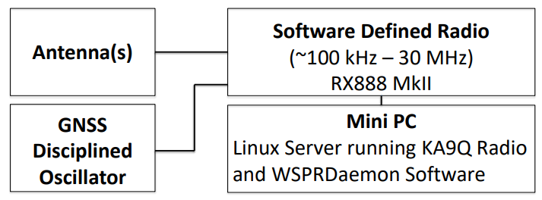
How does the psws work?
Antenna(s) capture HF signals across the 0.3–30 MHz range
Signals feed into an RX-888 MkII software-defined radio (SDR)
A mini PC runs KA9Q Radio and WSPRDaemon software to decode signals
A GNSS-disciplined oscillator ensures precise frequency timing
Decoded data (WSPR, FT8, FT4 spots) is sent to a central aggregation database
Data is used for both space science research and real-time amateur radio operations
Notes:
The HamSCI Personal Space Weather Station is a multi-instrument system designed to measure space weather for both scientific research and amateur radio operations. At its core is the RX-888 MkII software-defined radio, capable of capturing and analyzing signals across the 0.3–30 MHz range. The SDR is connected to a mini PC running KA9Q Radio and WSPRDaemon software, which decodes digital signals including WSPR, FT8, and FT4. A GNSS-disciplined oscillator provides precise frequency reference timing. Decoded spot data is aggregated into a central database like PSKReporter and WSPRnet, where it supports both scientific analysis of ionospheric conditions and, in this project's case, real-time propagation insights for amateur radio operators.

Slide 8
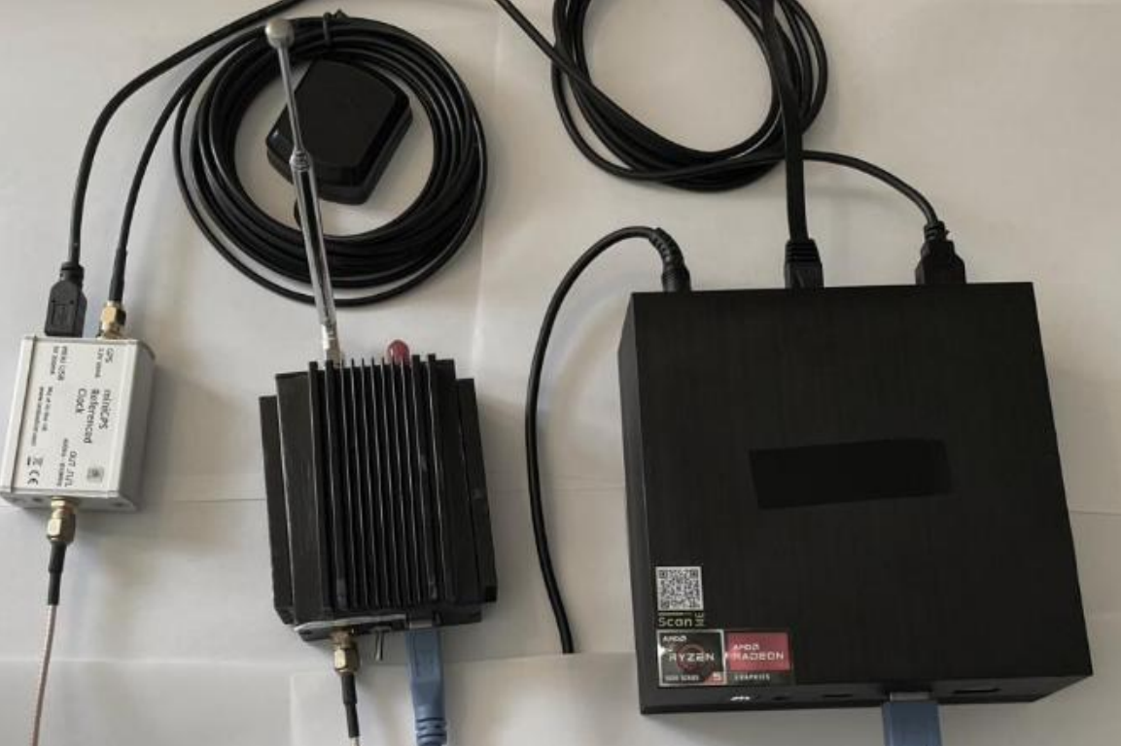
PSWS Layout
Notes:
Photo of Beelink mini PC, RX888, Leo bodnar GPS Oscillator all connected. This is the basic setup of all PSWS Stations. The beelink mini pc runs both KA9Q-Radio and WSPRDaemon.

Slide 9

KA9Q-Radio & wsprdaemon
KA9Q-Radio
  Open-source Linux SDR software developed by Phil Karn (KA9Q)
  Uses fast convolution and IP multicasting to digitally downconvert and demodulate hundreds of simultaneous channels from hardware like the RX-888
  Runs as a background service — no graphical interface needed
  Feeds processed signal data to downstream applications like WSPRDaemon
WSPRDaemon
  A robust Linux service for decoding WSPR and FST4W spots from SDR receivers
  Capable of measuring Doppler shift while receiving multiple standard frequency stations simultaneously, and decoding WSPR/FST4W digital mode signals
  Among the top spotting systems globally — collectively reporting around 33% of the 7+ million daily spots at wsprnet.org
Notes:
KA9Q-Radio is an open-source software defined radio package for Linux, written by Phil Karn (KA9Q). It uses fast convolution and IP multicasting to efficiently process signals from hardware like the RX-888, allowing hundreds of channels to be demodulated simultaneously with modest computing hardware. It runs silently in the background as a Linux daemon, feeding processed data to other applications. WSPRDaemon, developed by Rob Robinett (AI6VN), sits on top of KA9Q-Radio and handles the decoding of WSPR and FST4W digital mode signals. It can simultaneously monitor Doppler shifts on multiple standard frequency stations like WWV, and uploads all decoded data for scientific analysis. Together, these two software packages form the brain of the PSWS receiver system — KA9Q-Radio handles the raw signal processing, and WSPRDaemon handles the decoding and data reporting.

Slide 10
PSWS installation
OS: Ubuntu 24.04 LTS installed on Mini PC
Software: KA9Q-Radio + WSPRDaemon, installed and configured via command line
Configuration: WSPRDaemon config file sets your callsign, grid square, PSWS Reporter ID, and which bands/frequencies to monitor
PSWS integration: Once running, data is automatically uploaded to WSPRDaemon.org, wsprnet.org, and the HamSCI PSWS database
System is configured to restart automatically after power outages and run 24/7/365

Slide 11

PSWS Installation contd.
Modify RX888
  Configure Leo Bodnar to output 27 MHz
Mini PC BIOS Configuration
  Set fans to Full On Mode 24/7
  Set AC Power loss to “Always On” so the system automatically restarts after power loss
Operating System
  Install Ubuntu Server 24.04
    Disable snap to prevent unwanted automatic software updates
WSPRDaemon Configuration
  Set configuration via command line
  Run ./wsprdaemon.sh –V to complete installation
  Run wd –A to start wsprdaemon and enable it on boot
Notes:
The installation process has four main phases. For hardware, the RX-888 MkII is modified with a clock kit and thermal pad, the Leo Bodnar GPSDO is configured to 27 MHz output and connected to the RX-888 via SMA cable, and both devices are connected to the Beelink mini PC via USB. The BIOS is then configured to run fans at full speed at all times and to automatically power back on after any power outage, ensuring 24/7 operation. Ubuntu Server 24.04 LTS is then installed via a bootable USB drive, with snap disabled to prevent automatic updates from disrupting the WSPRDaemon scripts. Finally, the WSPRDaemon configuration file is edited with the operator's callsign, Maidenhead grid square, and PSWS station and device IDs obtained from pswsnetwork.caps.ua.edu. Running ./wsprdaemon.sh -V installs all remaining dependencies, and wd -A starts the daemon and registers it to launch automatically on boot.

Slide 12
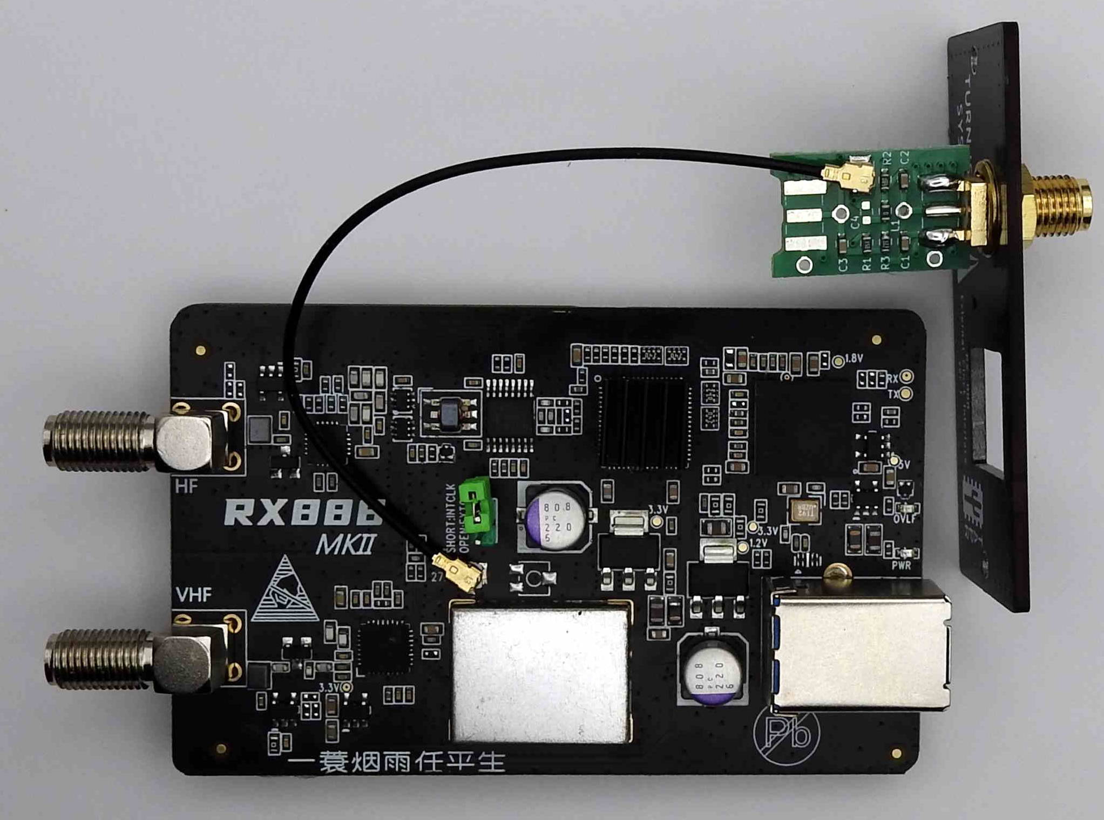
RX888 Modification
Modify RX-888 MkII with external clock kit and thermal pad for frequency accuracy and heat management
  Move internal jumper from closed to open
    Switches from internal clock to external clock
Add TAPR RX888 Clock Kit
Connect to Leo Bodnar
  Uses 27 MHz reference clock
  Internal Board connector to SMA
Kit also adds better heat dissipation for the entire board

Slide 13
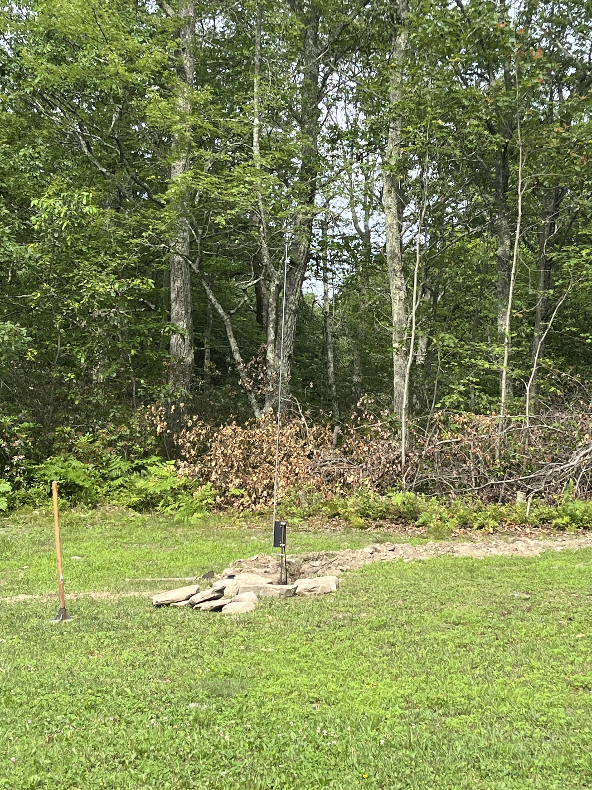
Antennas & leo bodnar
Antennas
  DX Engineering Active Magnetic Loop Antenna
  DX Engineering Receive Short Element Active Vertical Antenna
Leo Bodnar LBE-1421
  Frequency stability of its output is defined by the accuracy of GPS satellite onboard Caesium references and approaches 1x10⁻¹² or 0.000001 ppm.
  Drives the clock on the RX888, which allows for precise frequency measurements

Slide 14
KA9Q-Web
KA9Q-web is an adjunct to KA9Q-Radio that displays a spectrum, waterfall, and other data directly from the radiod software
Provides a browser-based interface to visually monitor the full HF spectrum being received by the PSWS system
WSPRDaemon typically starts it automatically — no specific configuration required
Accessible locally at http://localhost:8081 or remotely via an SSH Tunnel
Lets operators visually confirm the receiver is working and see live signal activity across HF bands
Notes:
KA9Q-web is a browser-based web interface that sits on top of KA9Q-Radio and provides a real-time visual display of the spectrum and waterfall from the PSWS receiver. It was originally created by John Melton (G0ORX) as a proof-of-concept in late 2023 and has since been significantly improved through collaboration between Scott Newell (N5TNL), Rob Robinett (AI6VN), Phil Karn (KA9Q), and others. WSPRDaemon starts it automatically as part of the normal system startup, so no additional configuration is needed. When accessed locally, it runs at http://localhost:8081; when managing the system remotely, it can be reached through an SSH tunnel. For the PSWS, KA9Q-web serves as a useful diagnostic and monitoring tool — operators can visually confirm the receiver is capturing signals, check band conditions at a glance, and see real-time activity across the full HF spectrum without needing to interpret raw data or command-line output.

Slide 15
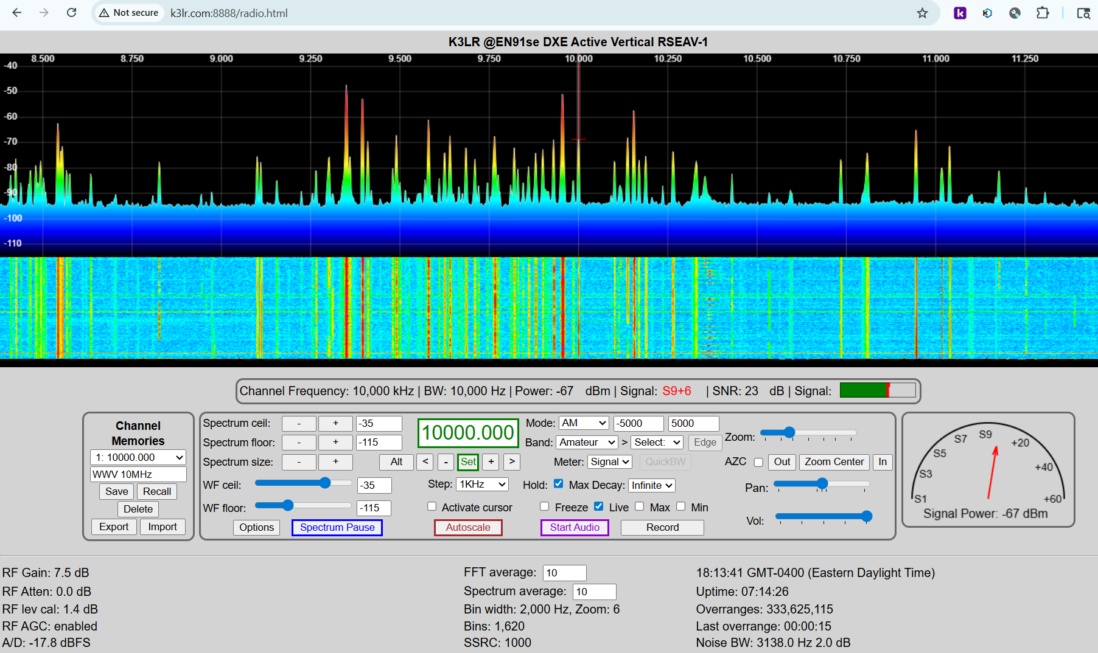
PSWS WEBSDR (ka9q-Web)

Slide 16

PSWS Reporting
Local Storage
  Decoded WSPR, FT8, FT4 and FT4 spots are stored in a local MongoDB database (wspr_db.spots) on the PSWS mini PC
  Each spot record contains: callsign, grid square, frequency, band, mode, SNR, drift, date, and time
  Database is the foundation for the contesting dashboard — the Flask app queries it directly in real time
Upstream Reporting
  Data is simultaneously uploaded to multiple external databases:
    wsprnet.org — the primary global WSPR spot aggregation network
    wsprdaemon.org — extended spot data including Doppler shift and noise measurements
    HamSCI PSWS Database (pswsnetwork.caps.ua.edu) — used for scientific research and ionospheric analysis
Uploads happen automatically and continuously, 24/7/365
What Makes WSPRDaemon Reporting Different
  Goes beyond standard WSPR decoding by also reporting Doppler Spread and true signal strength (Not just SNR)
  Noise measurements allow diagnosis of site RF Quality

Slide 17

Project background
The PSWS has driven significant scientific success — but little work has been done to make it useful for real-time amateur radio operations
This project bridges that gap by building a Contesting & DXing Dashboard for individual PSWS nodes
A core objective of HamSCI is to equally benefit both the scientific and amateur radio communities
Collaborative effort between:
  Frankford Radio Club (FRC) — mentor volunteers, contesting expertise, and project funding
  University of Scranton W3USR — student researchers and faculty
  HamSCI Community — scientific guidance and network infrastructure
Notes:
While the HamSCI PSWS network has enjoyed great scientific success — producing multiple peer-reviewed papers and a doctoral thesis — relatively little work has been done to make it a valuable tool for real-time amateur radio applications such as contesting, and DXing. This project directly addresses that gap. A core objective of HamSCI is to equally benefit both the amateur radio and professional scientific communities, and this dashboard is designed to do exactly that. The project is a collaborative effort between the Frankford Radio Club, which provides mentorship, contesting expertise, and funding; the University of Scranton W3USR club and Physics/Engineering Department, which provides students and faculty; and the broader HamSCI community.

Slide 18
Contesting & dxing dashboard
Real-time web application built using Flask, MongoDB, and Leaflet.js
Visualizes WSPR, FT4, and FT8 spots decoded by the PSWS receiver
Two primary views for the operator:
  Interactive Map View – Decoded spots with band specific color mapping
  Regional Band-Opening Table – activity across 14 geographic regions for the 6 primary contesting bands
Filters spots by bands, mode, country, continent, CQ Zone, and ITU Zone
Currently in testing at W3USR and also installed at K3LR
Notes:
The dashboard is a real-time web application developed to make PSWS data accessible and actionable for everyday ham radio operators, not just scientific researchers. It is built using Flask for the backend, MongoDB for data storage, and Leaflet.js for interactive mapping. The dashboard decodes and visualizes WSPR, FT4, and FT8 spots from the PSWS receiver in two views: an interactive world map with band-specific color coding and propagation path overlays, and a regional band-opening table showing activity across 14 geographic regions for the 6 primary contesting bands. Operators can filter spots by band, mode, country, continent, CQ Zone, and ITU Zone. A working prototype is currently live and was used operationally by the W3USR contesting team during the ARRL SSB DX Contest in March 2026. The system has also been installed at K3LR.

Slide 19
Timeline
Spring 2025
  Developed an idea and presented at the 2025 HamSCI Conference
Summer 2025
  Began development of the dashboard based off of ideas from 2025 HamSCI
  Installed at K3LR
Fall 2025
  Continued development of dashboard with feedback from both W3USR and FRC Feedback
Spring 2026
  Presented working prototype at 2026 HamSCI Conference

Slide 20
Requirements
Display & Visualization
  Real-time visualization of HF propagation conditions
  Interactive world map with band-specific color-coded spot markers
  Regional band-opening table across 14 geographic regions and 6 contest bands
Filtering
  Filter spots by band, mode (WSPR, FT8, FT4), country, continent, CQ Zone, and ITU Zone
  Configurable time window (last N minutes of spots)
  Auto-reload with adjustable interval (2–30 minutes)
Operator Experience
  Session-persistent filter settings across page reloads
Notes:
The design requirements were developed collaboratively between FRC mentors and University of Scranton students and faculty, with the goal of building a tool that answers the questions operators actually ask during contests and DX operations. The display requirements include a real-time interactive world map using Leaflet.js with band-specific colored markers and propagation path overlays, and a regional band-opening table showing activity across 14 geographic regions for the 6 primary contest bands. Operators can filter by band, mode, country, continent, CQ Zone, and ITU Zone, with all filter settings persisting across page reloads via session storage.

Slide 21
Requirements contd.
Answer key operator questions:
  What bands are open, and where?
  What is the current Maximum Usable Frequency (MUF)?
  Which band has the most activity?
  What direction are signals coming from?
Integration
  Decode and ingest WSPR, FT8, FT4 spots from the local PSWS Receiver
  Connect to external space weather data sources
Notes:
The system is designed to answer key real-time questions: what bands are open and where, what the current MUF is, which band has the most activity, and what direction signals are arriving from. Integration requirements include ingesting decoded WSPR, FT8, and FT4 spots from the local PSWS receiver and connecting to external space weather observations.

Slide 22
How does the dashboard work?
A WSPRDaemon config command instructs the system to store decoded WSPR spots into a local MongoDB database
A background program continuously parses each database entry and exposes the data through a REST API in JSON format — including callsign, grid square, frequency, band, and more
Two separate APIs serve the two dashboard views, as each requires a different data structure:
  Map API – feeds spot data to the Leaflet.js interactive world map
  Table API – feeds spot data into the regional band opening table
A web application pulls from both APIs in real time to render the live dashboard
Notes:
When WSPRDaemon decodes a WSPR spot, a setting in its configuration file directs those spots into a local MongoDB database. A separate background process runs continuously, parsing each entry in the database and formatting the data into a REST API that returns JSON — making fields like callsign, grid square, frequency, and band easily accessible to other programs. Because the map view and the regional band-opening table each require differently structured data, two distinct APIs were developed — one optimized for the map and one for the table. A Flask web application sits on top of both, pulling from each API in real time to render the dashboard for the operator.

Slide 23
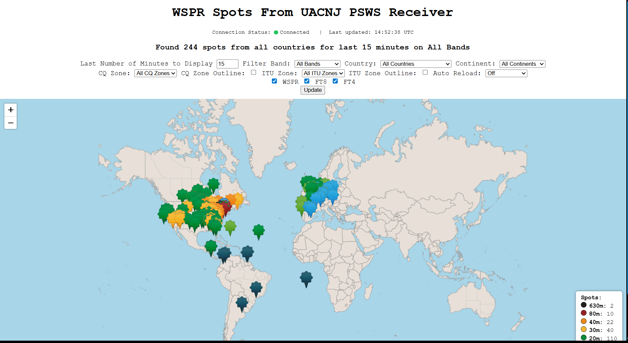
Map view

Slide 24
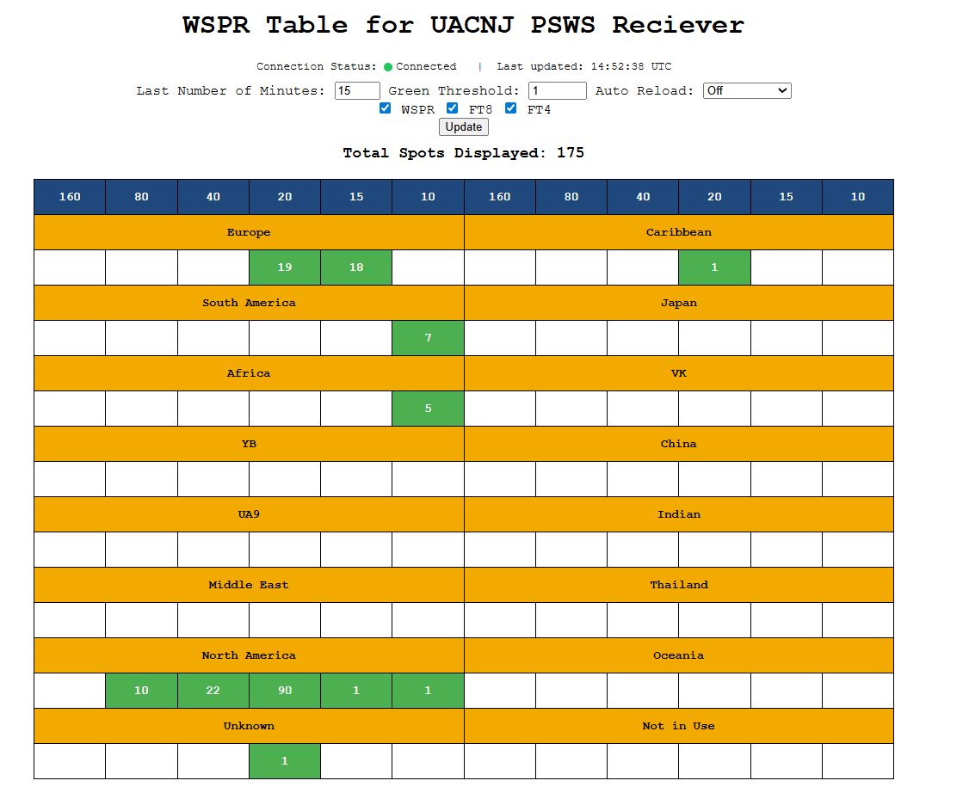
Table view

Slide 25
Current status
Dashboard
  Working prototype live at uacnj.kd3ald.com
  Successfully used in ARRL SSB DX Contest in March 2026
  Both map and table views fully operational with real-time spot visualization
  Filtering by band, mode, country, continent, CQ Zone, and ITU Zone implemented
Installation
  Prototype installed and live at K3LR
  Testing system operational at W3USR
Development
  Core data pipeline complete — WSPRDaemon → MongoDB → REST API → web app
  Two-API Architecture serving both map and table data
  Codebase open source and publicly available at github.com/hamsci/frc_contesting
Notes:
As of Spring 2026, the dashboard is a fully functional working prototype. It is live and publicly accessible, has been used operationally during the ARRL SSB DX Contest in March 2026, and has been installed at both K3LR and the W3USR station at the University of Scranton. The core technical architecture is complete — decoded spots flow from WSPRDaemon into a local MongoDB database, are served through two separate REST APIs, and rendered in real time on both an interactive world map and a regional band-opening table. The project was presented as a poster at the 2026 HamSCI Workshop. Active development is ongoing, with future features and broader deployment planned for the coming semesters.

Slide 26
Future work
Dashboard Enhancements
  Develop alerting functions to notify operators of specific band openings
  Integrate with external propagation sources like ITU-R HF
  Explore integration with N1MM+ logger for seamless in-contest use
  Expand to support multiple simultaneous PSWS receivers for broader propagation comparisons
  Develop session-persistent filter settings so operators can return to preferred configurations
Deployment & Testing
  Install and test at volunteer contest stations
  Collect and incorporate operator feedback into dashboard design
  Continue use and testing during W3USR contesting operations
Notes:
Future development will focus on several fronts. On the dashboard side, planned features include band-opening alerts, integration with ITU-R HF propagation models, and compatibility with the N1MM+ contest logging software — which would make the dashboard seamlessly usable during active contests. Expanding the system to pull from multiple simultaneous PSWS receivers would allow broader regional propagation comparisons. On the deployment side, the next step is installing and testing at additional volunteer contest stations and collecting structured operator feedback to guide further development.

Slide 27
Scientific contributions
Expand PSWS Network across North America
Contribute to broader understanding of localized and global HF conditions
Strengthen the bridge between amateur radio operations and space weather research
Notes:
Scientifically, the dashboard contributes to a broader understanding of localized and global HF conditions, and as the PSWS network continues to expand across North America, the dataset available to both operators and researchers will only grow richer.

Slide 28

Thank you!
We are especially grateful for the
support of NSF Grants AGS-2045755, AGS-2432821, AGS-2432822, AGS-2432824, and AGS-2432823, and NASA grants 80NSSC23K1322 and 80NSSC25K7026
support of Amateur Radio Digital Communication (ARDC).
amateur radio community volunteers who have contributed to HamSCI projects.
amateur radio community who voluntarily produced and provided the HF radio observations used in this paper, especially the operators of the Reverse Beacon Network (RBN, reversebeacon.net), the Weak Signal Propagation Reporting Network (WSPRNet, wsprnet.org),
PSKReporter (pskreporter.info) qrz.com, and hamcall.net.
use of the Free Open Source Software projects used in this analysis: Ubuntu Linux, python (van Rossum, 1995), matplotlib (Hunter, 2007), NumPy (Oliphant, 2007), SciPy (Jones et al., 2001), pandas (McKinney, 2010), xarray (Hoyer & Hamman, 2017), iPython (Pérez & Granger, 2007), and others (e.g., Millman & Aivazis, 2011).
Ann Marie Rogalcheck-Frissell KC2KRQ for the HamSCI silhouette photograph.

