Slide 1

🎈
TELEMETRY VIA REPURPOSED WSPR FOR PICO BALLOONS
Stewart Clark ZR1WT

Slide 2

Agenda
Typical Pico Balloon Setup - hardware and the launch
Start of sending telemetry from Pico Balloons using JT9
Standard/Basic telemetry (U4B protocol)
How it is encoded into WSPR packets
Extended Telemetry (eg ET0, and Generic ET)
Science extracted from these Pico Balloon Flights

Slide 3
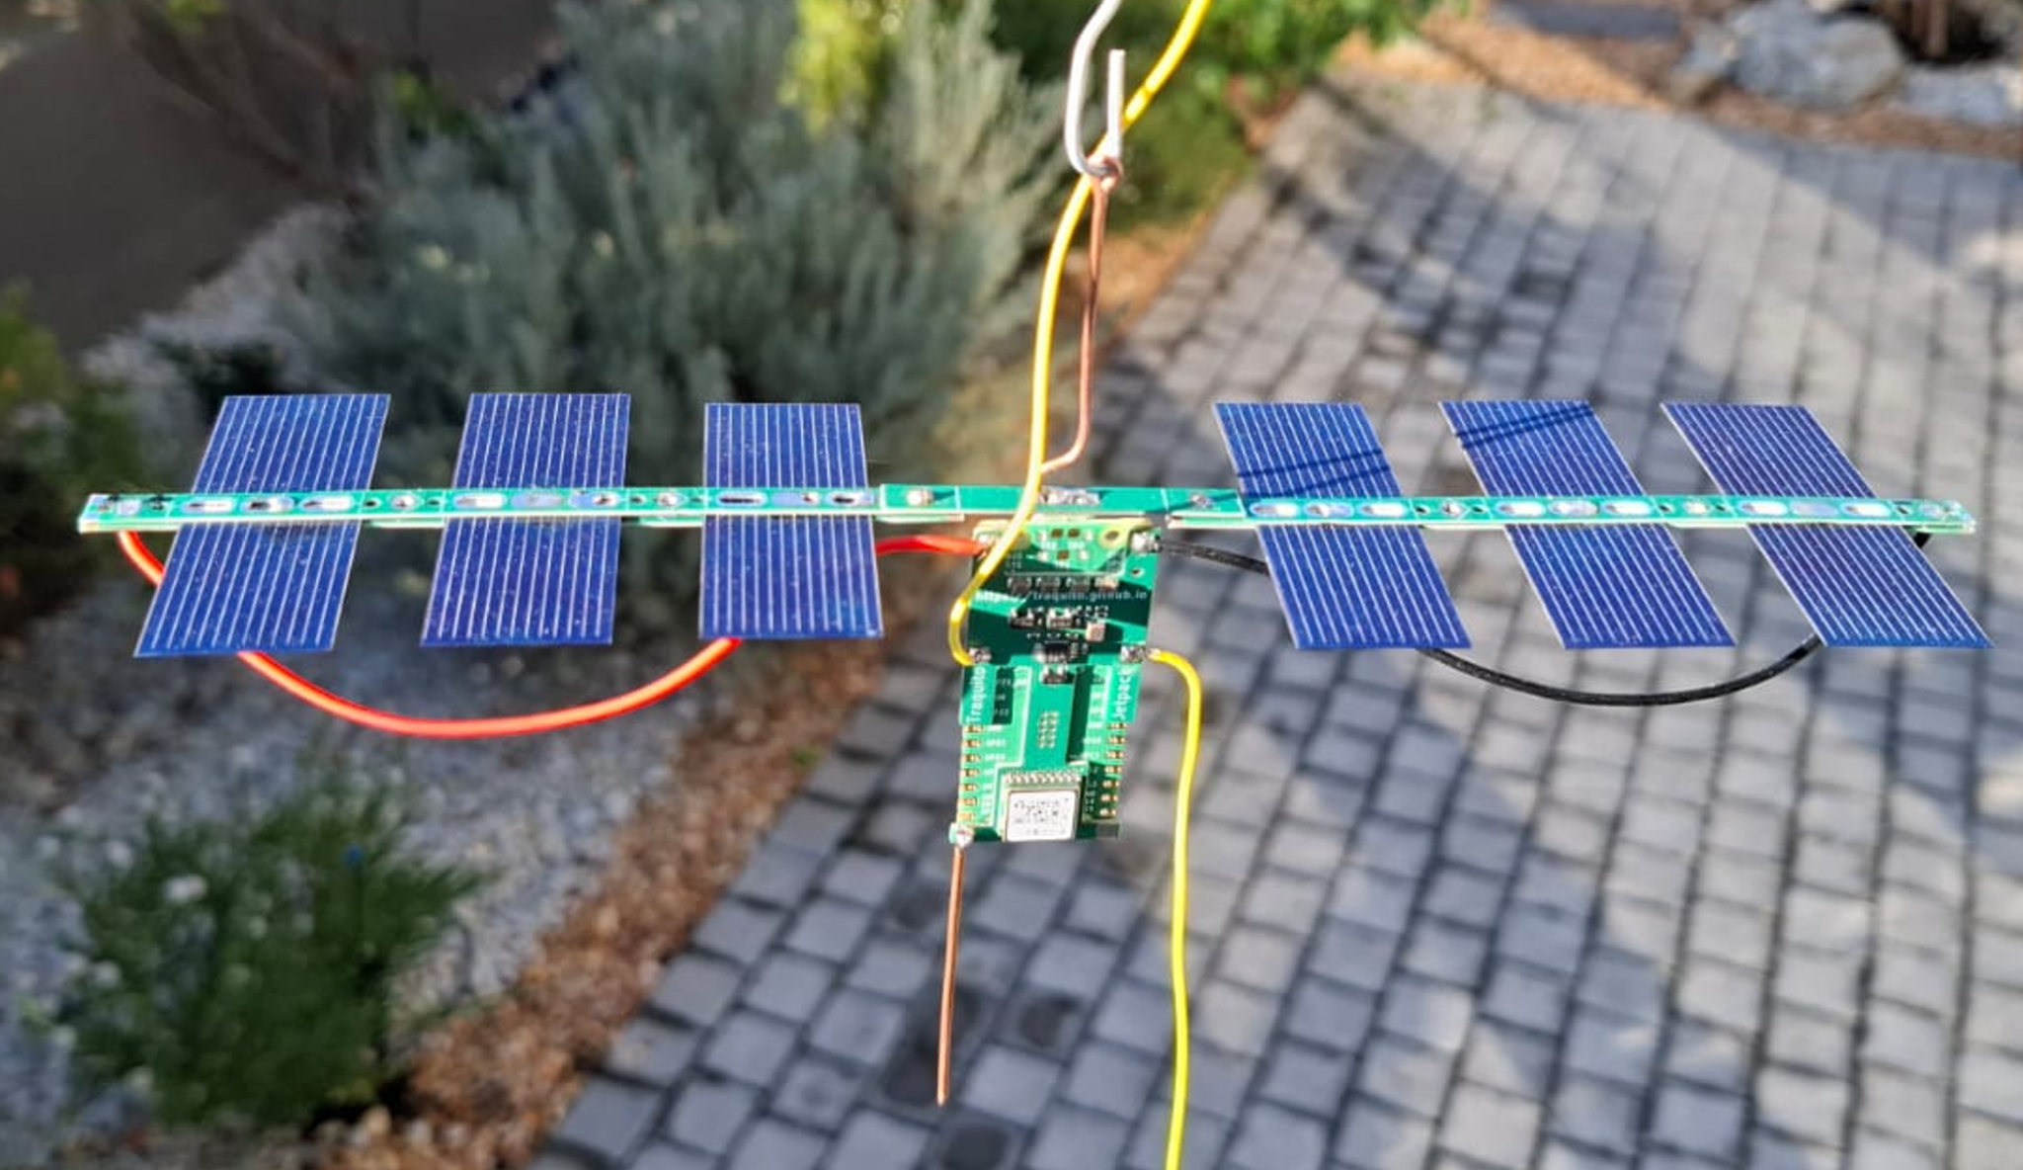
BACAR: Balloon Carrying Amateur Radio
Around the world amateurs build tiny radio payloads and launch them into the Stratosphere: 14,500–50,000m
using a balloon filled with helium or hydrogen.
Notes:
On Saturday 16th August 2025, Stewart ZR1WT in conjunction with the Eden Radio Club ZS1ERZ successfully launched a high altitude pico balloon, ZS1ERZ-12 (channel 24), with a WSPR beacon as the payload from the Ystervark Point Lighthouse as part of ILLW (international lighthouse and lightship weekend).

Slide 4

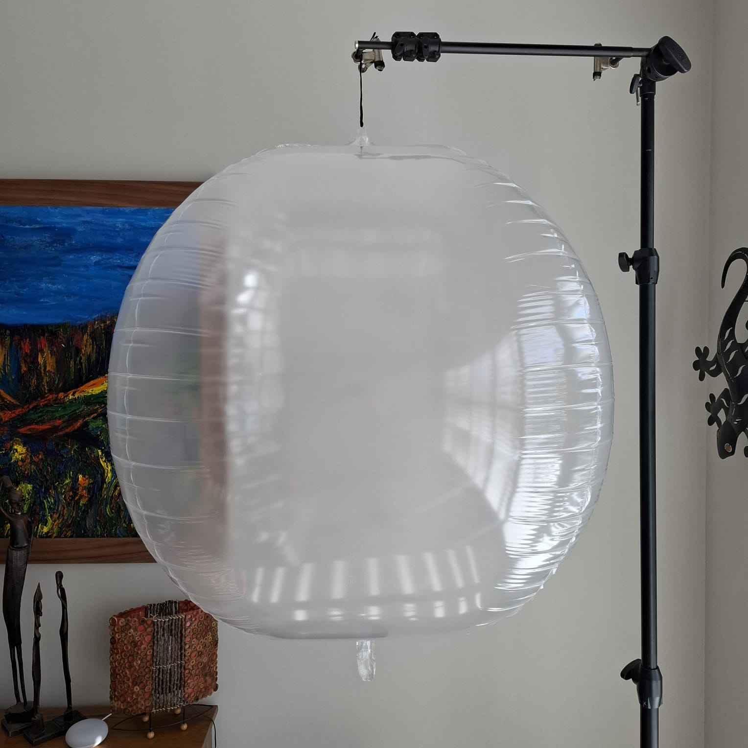
Balloon Details
The balloon typically used is a 0.95 metre diameter mylar transparent balloon. First it is inflated with air to stretch it and get the wrinkles out.
Then check for leaks by keeping it under pressure a number of days.

Slide 5
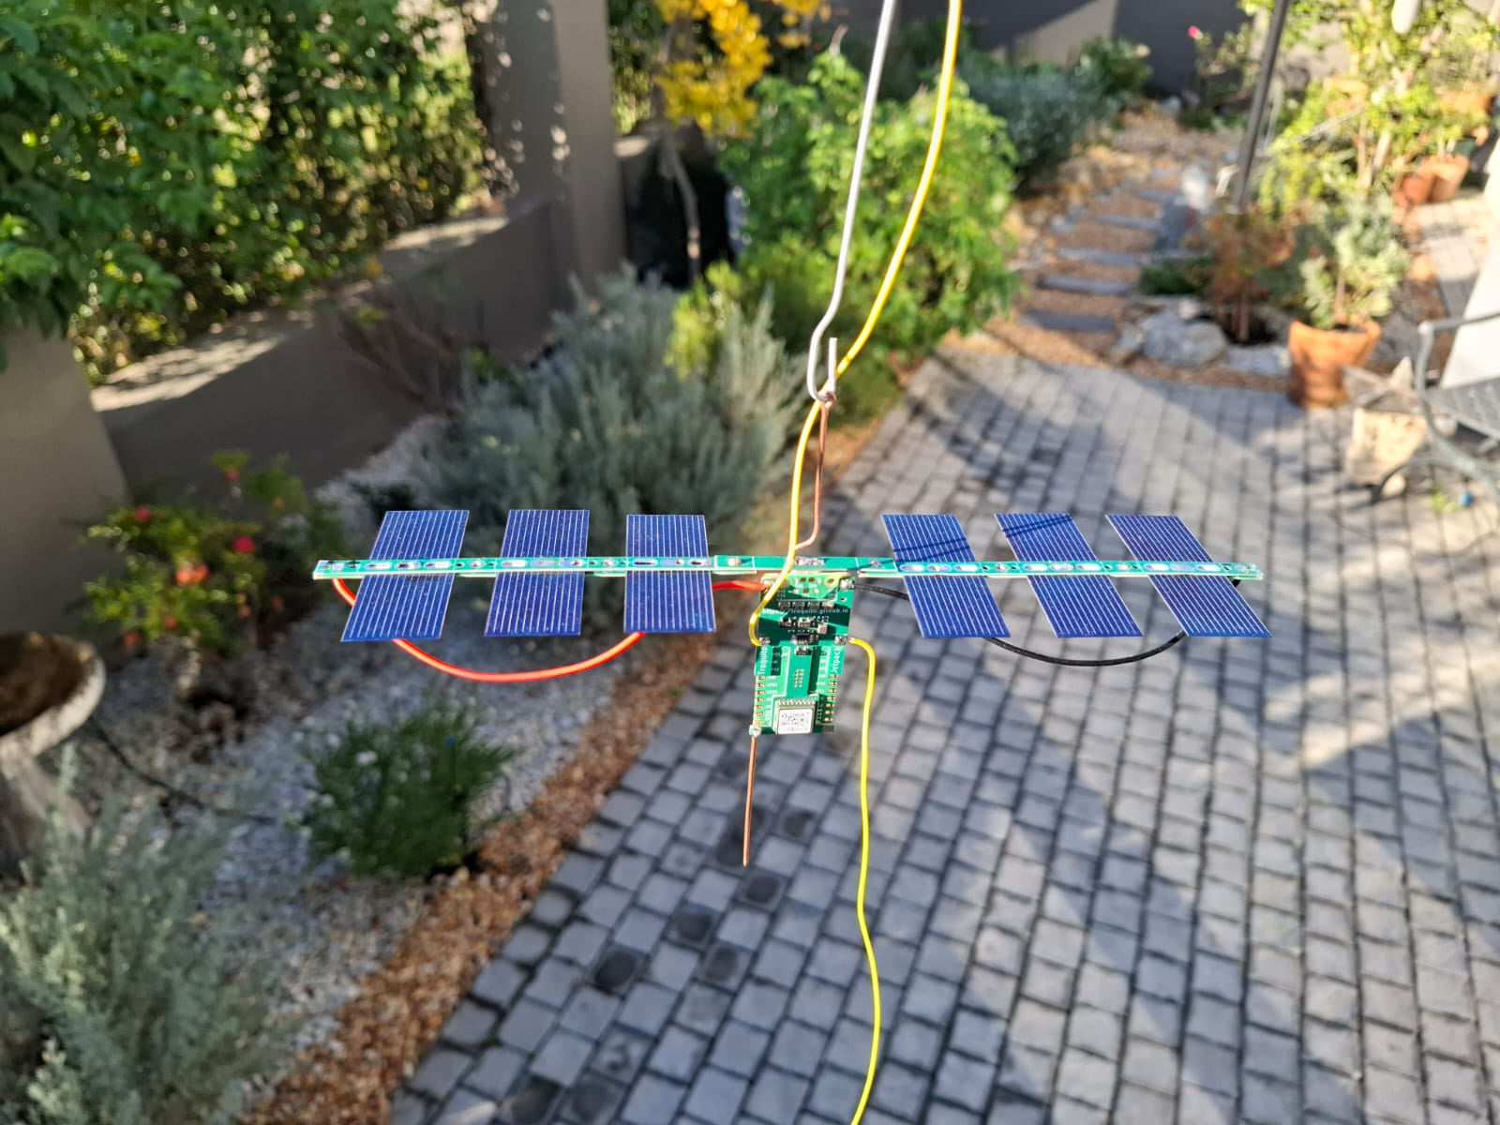
Payload Details
Typical payload is a WSPR beacon transmitting in the 10m or 20m band at a power of 20mW.
Additional telemetry, eg altitude and temperature is also TXed
It is powered by 6 tiny solar panels each producing 0.5 volts at 400mA, with a total of 3 volts. However in full sunlight it can be over 4V.
This is the only means of power - there is no battery on board - hence the payload only transmits during daylight when the sun is shining.
Further, the angle of incidence of the sun on the solar panels needs to be > 20 degrees in order for sufficient power.
Notes:
WSPR - Weak Signal Propagation Reporter
10m - 28.126MHz

Slide 6
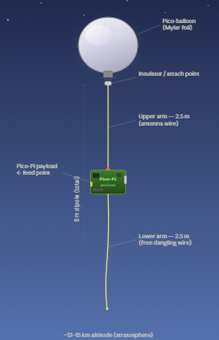
Payload Electronics
The WSPR beacon is constructed using a Raspberry Pico-Pi as the processor with an add-on board from Traquito that provides:-
GPS (ATGM336H)
Radio Transmitter (SI5351A) + 0.5ppm TCXO
Voltage Monitor
The beacon requires an HF antenna, and an efficient lightweight antenna is a ½ wave dipole. For the 10m band (WSPR dial frequency is 28.1246 MHz) this is a 5.07m dipole.
The antenna is oriented vertically with the one end attached to the balloon, the Pico-Pi + Traquito board in the middle at the feed point, with the remaining ½ of the dipole (2.54m) suspended below the payload electronics.

Slide 7
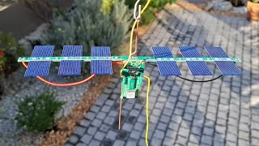
BACAR: Balloon Carrying Amateur Radio
Pico Balloon Mission ZS1ERZ-12
(use the 2nd balloon - simpler video?)

Slide 8
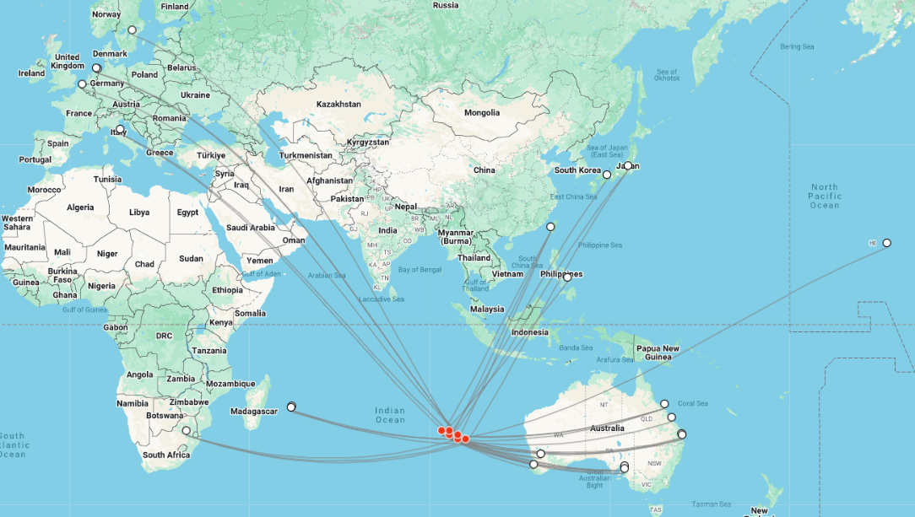
WSPR Beacon and Spotting
WSPR is a great way to monitor the balloon as there are 10,000’s of amateurs that have automatic WSPR receivers listening 24/7.
Each time a valid WSPR message is successfully decoded, it is uploaded to WSPR website: https://www.wsprnet.org/
So even if I cannot receive the signal myself due to bad propagation conditions from balloon to my location, others may receive it and report it.
On the right we have a typical graphic from a WSPR decoding website eg wspr.rocks. Red dots being the balloon and white dots the spotters.
This, however, only displays location and the signal strength as received by the spotter.

Slide 9
WSPR is only 1 Approach
Not all pico balloons use WSPR as a means for telemetry, some use APRS, or even Lora
Or combinations:
WSPR to tell you where the balloon is and to see where its going
Lora to dump down data when it gets within range of a receiver.

Slide 10
Why use WSPR as a basis?
High-altitude pico balloons require extremely low mass payloads and very low power consumption.
They TX at just 20mW!
Traditional telemetry transmitters were too complex and power-hungry for balloons weighing only a few grams - not to mention setting up specialised receiving stations.
The global WSPR (Weak Signal Propagation Reporter) network already provides:
Worldwide receiver coverage
Extremely sensitive decoding (signals approx −28 dB SNR)
Automatic internet reporting
This suggests that the WSPR network itself could serve as a global telemetry reception system if telemetry data could be encoded inside the WSPR message format.

Slide 11
Early Pico Balloon Tracking
Andy Nguyen (VK3YT) pioneered long-range pico balloon tracking using JT9
Part of the WSJT-X suite developed by Joe Taylor K1JT and allows global reception with only milliwatts of TX (sensitivity -27 dB SNR deep in the noise)
However, Andy used custom telemetry encoding which required a modified version of WSJT-X to be distributed to HAMS around the world wanting to decode the telemetry. Not ideal.
Hans Summers G0UPL proposed an innovative twist
Encode all telemetry directly into WSPR-like packets, allowing the global network of existing WSPR monitoring stations to unknowingly receive and upload the data to the WSPRnet database without needing special receivers or software.
This maximized reception potential for telemetry as there are already 1000s of HAMS with standard WSTJ-X receiving and decoding WSPR
And of course at an even better sensitivity of -28dB SNR (deep in the noise)

Slide 12
WSPR Message Content
A standard WSPR transmission contains three fields:
6-character callsign (28 bits)
4-character Maidenhead grid locator (15 bits)
Power level (7 bits)
These fields combine to form a 50-bit message.
The 50-bit message is convolutionally encoded (rate ½, K=32), interleaved, and combined with a synchronization vector to produce 162 symbols which are transmitted using:
4-FSK modulation (4-tone Frequency Shift Keying)
Symbol rate: 1.4648 baud
Total transmission time: 110.6 seconds using about 6Hz bandwidth
Notes:
In WSPR protocol encoding, the original 50-bit message is first passed through a convolutional encoder with rate ½ and constraint length 32, where each input bit is converted into two output bits using generator polynomials applied to a 32-bit shift register, meaning every output depends on the current bit and the previous 31 bits; this long memory spreads the information across the stream and provides strong redundancy, allowing powerful error correction at the receiver using algorithms such as Viterbi decoding. The encoded bitstream is then interleaved, rearranging the order of bits so that burst errors from fading or interference are dispersed rather than clustered, improving decoding reliability. A known synchronization vector is then combined with the data to provide a reference for precise time and frequency alignment at the receiver. The final result is mapped into 162 symbols, which are transmitted using a very narrowband modulation scheme optimized for extremely weak signals, enabling reliable decoding well below the noise floor.

Slide 13
Std WSPR, followed by Telemetry WSPR
The Pico-Balloon payload would still send a standard WSPR packet containing the Callsign, Grid4 location and a power level.
The proposed repurposed WSPR packet containing the encoded telemetry data would be sent immediately after the WSPR packet.
That is, in every 10 minute cycle the 1st 2 mins would be a standard WSPR packet, followed directly afterwards with a 2 minute telemetry packet, a total of 4 minutes.

Slide 14
WSPR and Telemetry Linking
To link this telemetry WSPR packet with the base WSPR packet, and to cater for and identify multiple trackers all transmitting in the same band, the concept of a channel number (0-599) was devised.
The channel number is encoded into 3 aspects of the telemetry packet
Callsign 1st and 3rd chars
Set the even numbered minute slot within the 10 min cycle and..
The lane (frequency within 200hz WSPR bandwidth) to transmit in.

Slide 15
WSPR and Telemetry Linking continued..
Part of the channel number is encoded into the telemetry callsigns 1st and 3rd chars
  1st char: 0,1,or Q (not a valid callsign)
  3rd char: 0-9
Part of the channel number determines the lane in which that tracker should transmit in
  4 lanes have been specified which correspond to 1 of 4 frequencies in the WSPR band to TX in.
  The WSPR band width is 200hz and this is divided into 4 lanes.
  For example in the 10m band, the 4 lanes are centred on
28,126,020Hz
28,126,060Hz
28,126,140Hz
28,126,180Hz
The even numbered minute slot within the 10 min cycle in which to start TXing
  i.e. 0,2,4,6,8 (there are 5 slots in a 10 min cycle)

Slide 16
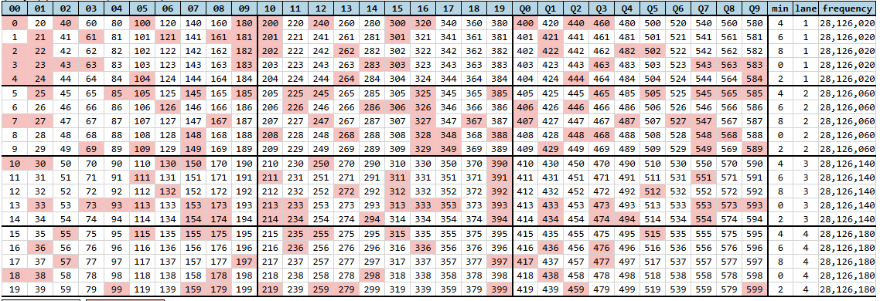
Channel Map to Reserve a Call Sign
Channel map configuration is provided by Tratuito https://traquito.github.io/channelmap
There are 600 channels for each WSPR band available
Reservations are by the callsign used in the WSPR packets.

Slide 17
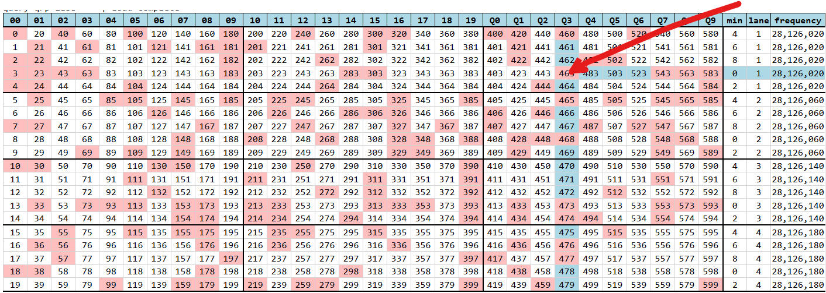
Channel Map to Reserve a Call Sign
For example, a tracker that has been assigned channel 463, in the 10m band
Callsign 1st and 3rd chars will be “Q” & “3” respectively of the telemetry packet
Start transmitting with the std WSPR packet in the 0th minute of each 10 min segment, followed by the telemetry packet/s (more than 1 can be sent)
TX in lane 1 which has a central frequency of 28,126,020Hz.

Slide 18
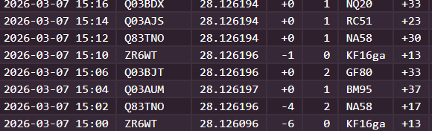
Typical WSPR decodes
Here we have the std WSPR entry (ZR6WT) followed by 3 telemetry WSPR packets.
1st WSPR packet is as expected with ZR6WT, grid 4 and TX power level
Telemetry packets follow immediately after the WSPR packet.
The channel is 463, so the 1st and 3rd chars of the callsign are “Q” and “3”. This and the timing (starts on 0th min) are used to link these telemetry packers to the initial WSPR packet.

Slide 19
Interpreting these telemetry packets
There are few websites that can interpret these telemetry packets:
Tracking sites such as traquito.github.io, wsprtv.com, lu7aa.org, and qrp-labs.com use this channel information, which includes the specific 2 minute slot that packet is sent in, to combine the packets and present the balloon’s position and telemetry in a human-readable form.
The picoballoon’s track is also shown on a map.
More on this later.

Slide 20
Standard Telemetry to Encode (U4B)
Hans Summers, settled on the follow standard telemetry:
Locator56 (the last 2 chars of a 6 char grid) eg “ga” from KG16ga
Altitude 0m to 21340m
Temperature -50C to 39C
Voltage 3 to 4.95V
Speed 0 to 82 knots
GPSValid = 0 or 1
HdrTelemetryType = 0 or 1 (std telemetry)

Slide 21
How to Encode the Telemetry
Real-world measurements (temperature, voltage, pressure, etc.) are continuous or high-resolution, so as is well known, must be mapped to bounded integer ranges (i.e. normalised and quantised).
Selecting suitable step sizes leads to the following bit usages
(using Log2 of quantisation):
Locator56 (last 2 chars can be A-X ie 24*24 combinations) 576 values (9.2 bits)
Altitude 0m to 21340m, steps of 20m,1068 values (10.1 bits)
Temperature -50C to 39C, steps of 1C, 90 values (6.4 bits)
Voltage 3 to 4.95V, steps of 50mV, 40 values (5.3 bits)
Speed 0 to 82 knots, steps of 2 knots, 42 values (5.4 bits)
eg Voltage would be stored as 0-39 etc

Slide 22
Encode using Mixed Radix Packing
One approach would pack the fields next to each other. But of course eg Locator56 is 9.2 bit field would require 10 bits etc.
There is a better way resulting in no wasted bit space: mixed radix packing
The radix refers to the quantisations of the various telemetry components.
All the telemetry fields are encoded using mixed radix packing into a single large number.
Then use mixed radix unpacking of this large number into the 3 WSPR fields each having their own and different quantisation.
(details to follow)

Slide 23
Mixed-Radix Packing Technique
The technique of mixed radix packing combines fields of different ranges into a single large integer
Using an example of 3 fields with different quantisations will demonstrate the technique.
v1_size = 50 (radix 50 ie 50 different values after Quantisation of the values)
v2_size = 20
v3_size = 80
From the above quanitisation, we require 50*20*80 = 80,000 distinct values to encode the 3 variables into a BigNum
Log2 80,000 = 16.28 bits
Log2 50 = 5.64 bits
Log2 20 = 4.32 bits
Log2 80 = 6.32 bits
Total 18 (when rounding up to the nearest whole number of bits)

Slide 24
Encoding Example
v1_size = 50 (radix 50 ie 50 different values after Quantisation of the values)
v2_size = 20
v3_size = 80
BigNum = 0 (encode in reverse order)
BigNum = BigNum * v3_size + v3
BigNum = BigNum * v2_size + v2
BigNum = BigNum * v1_size + v1
eg V1=42, v2=17, v3=65
BigNum = ((0*80 + 65)*20 + 17)*50 + 42 => 65,892
This guarantees a reversible mapping.

Slide 25
Decoding
v1_size = 50 (radix 50 ie 50 different values after Quantisation of the values)
v2_size = 20
v3_size = 80
eg v1=42, v2=17, v3=65
Restoring v1,v2 & v3 is a reverse of the encoding (an example shows how)
BigNum = 65,892 (from the previous slide)
v1 = BigNum % 50 => 42 (as v1 was added last, a simple modulus using the radix will restore it)
v2 = (BigNum // 50) % 20 =>17 (v2 was encoded 2nd. Start by dividing out v1, then apply the modulus of v2 radix)
v3 = ((BigNum // 50) // 20) % 80 => 65 (simily divide out v3,v2 before appling the v3 mod radix)

Slide 26
Big Number - now what?
So we have encoded the telemetry values Locator56, Altitude, Temperature, Voltage, and Speed using mixed radix packing into a Big Number.
How to we send this as a WSPR packet?
The trick is to unpack this Big Number into the 3 WSPR fields: Callsign, Grid and Power Level using the quantisation of these fields.
What we have done is effectively re-encoded our telemetry values to 3 other fields.
On the receiving end, to recover, we would again encode the 3 WSPR fields into the BigNumber, and then decode using the quatisation of the telemetry fields back into the original telemetry items.

Slide 27
Decoding BigNumber into WSPR fields
In practice, the technique partitions the telemetry fields into 2 groups, that is 2 big numbers. The 1st will be decode into the 6 char callsign (632,736 values) and the 2nd will decode into the 4 char grid and power level (615,600 values)
The telemetry values chosen for 1st big number: Locattor56, Altitude
Quantisation: 576*1068 = 615,168
The telemetry values chosen for 2nd big number: Temperature, Voltage, Speed, GPSValid and HdrTelemetryType
Quantisation: 90*40*42*2*2 = 604,800
The quantisation of the 6 char callsign is just slightly bigger than the 2 telemetry fields, so will work without loss. Similarly for the 4 char grid and power level of the WSPR packet.

Slide 28
WSPR Fields Quantisation
WSPR has 3 fields: Callsign6, Grid4 and Power Level
Callsign6 is in the form of aanxxx where a=alpha numeric (A-Z, 0-9) and n = 0-9, x = A-Z, Blank
C1 & C3 are already spoken for, that is they have fixed values for a particular channel in the band. In our early example (of chan 463) it is Qx3xxx where 1st and 3rd are fixed at Q and 3 respectively and the xxx are available for encoding of the telemetry.
C2 is alphanumeric (quantisation of 36 integer values)
C4, C5, C6 can be A-Z (including blank if the trailing chars), hence a quantisation of 27
Hence the Callsign6 space is 36*27*27*27 can accommodate 632,736 values
Grid4 has the format: a a n n
a = A–R (18 values)
n = 0–9 (10 values)
Power Level contains 19 allowed values: [0,3,7,10,13,17,20,23,27,30,33,37,40,43,47,50,53,57,60]
Hence Grid4 & Power Level space is 18*18*10*10*19 can accommodate 615,600 values

Slide 29
Why only 38.5 bits of the 50bits?
In total the telemetry requires 615,168 * 604,800 => 372 053 606 400 possible values requires ~ 38.4 bits
The WSPR packet has a total space of 50 bits available for data.
However, because C1 & C3 are used for linking, these 936 values (9.8 bits) are lost.
Further, of the 7 bits allocated to the power level, only 4.2 (corresponds to 19 values) are available (the rest are used for WSPR type internals),
Finally we have 38.5 bits usable.
CALLSIGN_CAPACITY = 36 * 26 * 26 * 26 # 632,736 In Extended Telemetary callsign PXNAAA where P (P:0,1,Q) & N are fixed for the channel, so only have 3 Alphas and 1 Alpha/Numeric (X) available.
GRIDPOWER_CAPACITY = 18 * 18 * 10 * 10 * 19 # 615,600 AANNP (A:A-R, N:0-9, P:19 values)
TOTAL_CAPACITY = CALLSIGN_CAPACITY * GRIDPOWER_CAPACITY -> 389,512,281,600 (~ 38.5 bits )

Slide 30
Telemetry Fields mapped to Callsign6 fields
To use our real world example, the following telemetry parameters are encoded in the Callsign6 field.
Parameter | Range | Quantisation | Values | Normalisation
Locator56 … |  |  | 576
Locator5 | A-X | 1 | 24 | 0 - 23
Locator6 | A-X | 1 | 24 | 0 - 23
Altitude | 0 - 21340m | 20 m | 1068 | 0 - 1067
The telemetry values are packed into a single integer using multi-radix packing, starting with Locator5 ordinate value (0-23):
Encoding to get the Callsign6 Bignumber:
BigNum = (Locator5_ord*24 + Locator6_ord)*1068 + Altitude_int

Slide 31
Reverse Multi-Radix Unpacking
The WSPR callsign is 6 chars long, of which c1 & c3 are already spoken for (encodes the channel#)
Callsign format C1C2C3C4C5C6 or pXnAAA where p (0,1,Q) & n are fixed for the channel, so only have 3 Alphas and 1 Alpha/Numeric (X) available.
Reverse radix encoding using the quantisation of various callsign characters
c6 = chr(BigNum % 26 + 65)
BigNum //= 26
c5 = chr(BigNum % 26 + 65)
BigNum //= 26
c4 = chr(BigNum % 26 + 65)
BigNum //= 26
msw = BigNum % 36
c2 = chr(msw + ord(‘0’)) if msw < 10 else chr(msw - 10 +ord(‘A’)) (normalisation depending on 0-9 or A-Z)
Finally
callsign6 = c1 + c2 + c3 + c4 + c5 + c6

Slide 32
Telemetry Fields mapped to Grid4 & Pwr fields
The following telemetry parameters are encoded in the Grid4 and Power fields.
The telemetry values are packed into a single integer using multi-radix encoding, starting with Temperature:
BigNum = (((Temp_int * 40 + Bat_int) * 42 + Speed_int) * 2 + GPSValid) * 2 + HdrTelemetryType)
Parameter | Range | Quantisation | Values | Normalisation
Temperature | −50 to +39 °C | 1 °C | 90 | + 50 -> 0 to 89
Battery voltage | 3000–4950 mV | 50 mV | 40 | -3000 -> 0 to 39
Speed | 0–82 knots | 2 knots | 42 | -> 0-41
GPSValid | 0 or 1 | 1 | 2 | -> 0 or 1
HdrTelemetryType | constant = 1 | 1 | 2 | -> 0 or 1

Slide 33
Mapping to WSPR Grid and Power
The integer is then converted into the Grid4 and Power fields.
Grid4 has the format: a a n n
where:
a = A–R (18 values)
n = 0–9 (10 values)
The WSPR power field contains 19 allowed values:
[0,3,7,10,13,17,20,23,27,30,33,37,40,43,47,50,53,57,60]

Slide 34
Reverse Multi-Radix Extraction
The grid and power values are extracted by reversing the multi-radix process:
power_index = BigNum % 19
BigNum //= 19
D = BigNum % 10
BigNum //= 10
C = BigNum % 10
BigNum //= 10
B = BigNum % 18
BigNum //= 18
A = BigNum % 18

Slide 35
The final WSPR fields are then Constructed
grid =
chr(A + 65) +
chr(B + 65) +
chr(C + 48) +
chr(D + 48)
power = POWERS[power_index]
Where POWERS = [0,3,7,10,13,17,20,23,27,30,33,37,40,43,47,50,53,57,60]

Slide 36
Telemetry -> WSPR -> Telemetry
Telemetry
Locator56
WSPR
Altitude
Call SIgn 6
Temp
Multi Radix Encode
Multi Radix Decode
Grid 4
Voltage
Big Number
Power
TX
Speed
Multi Radix Decode
Multi Radix Encode
GPSValid

Slide 37
Typical WSPR decodes seen
Here we have the std WSPR entry (ZS6WT) followed by 3 telemetry packets.
The 1st telemetry packet is the standard one and always follows immediately after the WSPR packet.
The 2nd and 3rd are extended telemetry and can contain any data as long as it doesn't require more than 38.5 bits

Slide 38
Interpretation and Visualisation
Tracking sites such as traquito.github.io, wsprtv.com, lu7aa.org, and qrp-labs.com use this channel information to combine the two packets and present the balloon’s position and telemetry in a human-readable form.
Long running ZS1ERZ-12 (last 6 months)
https://wsprtv.com/?cs=ZS1ERZ&ch=24&band=10m&start_date=2025-08-16&end_date=2026-02-13

Slide 39
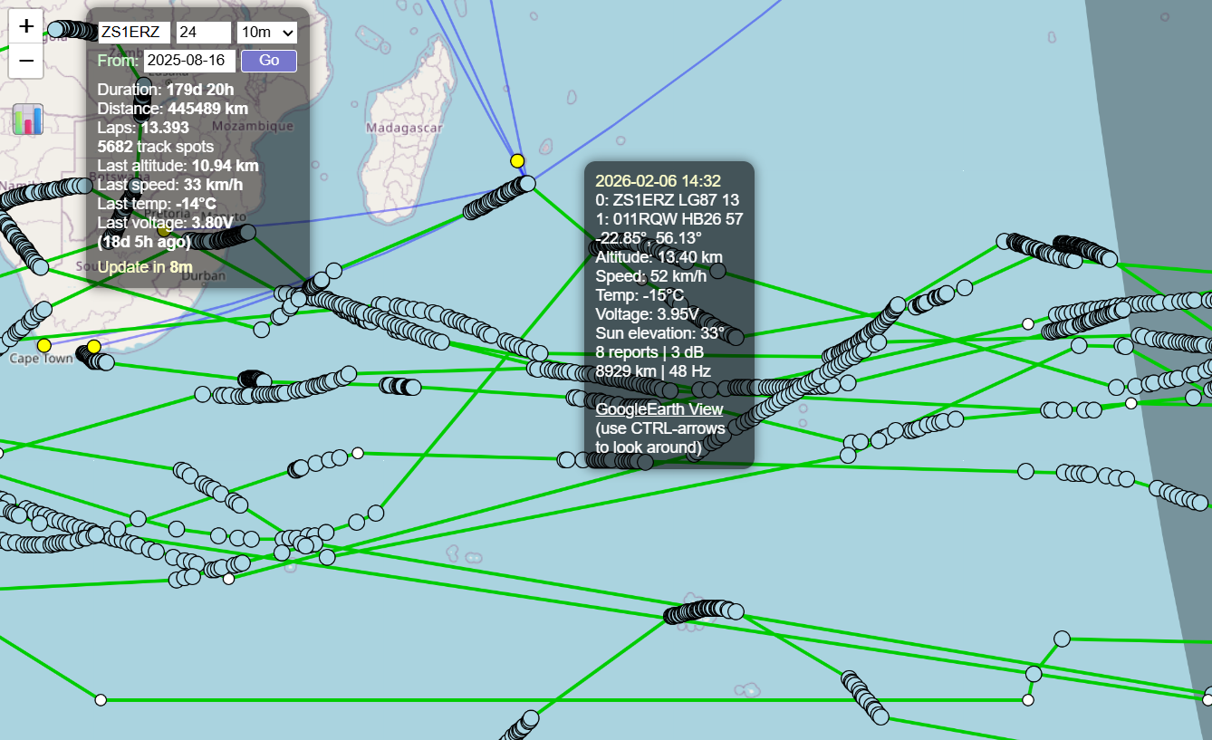

Slide 40
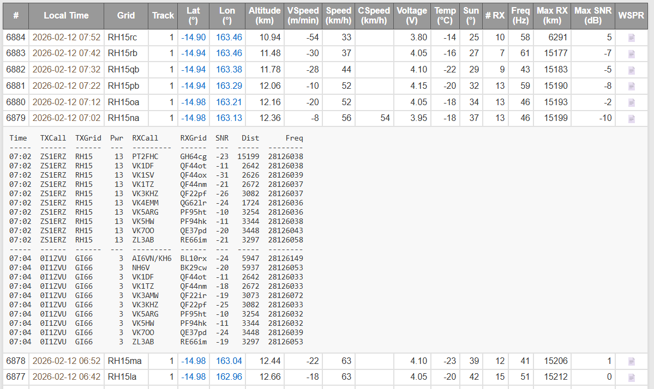
Telemetry Detail and who Spotted it
Telemetry detail and who spotted it.

Slide 41
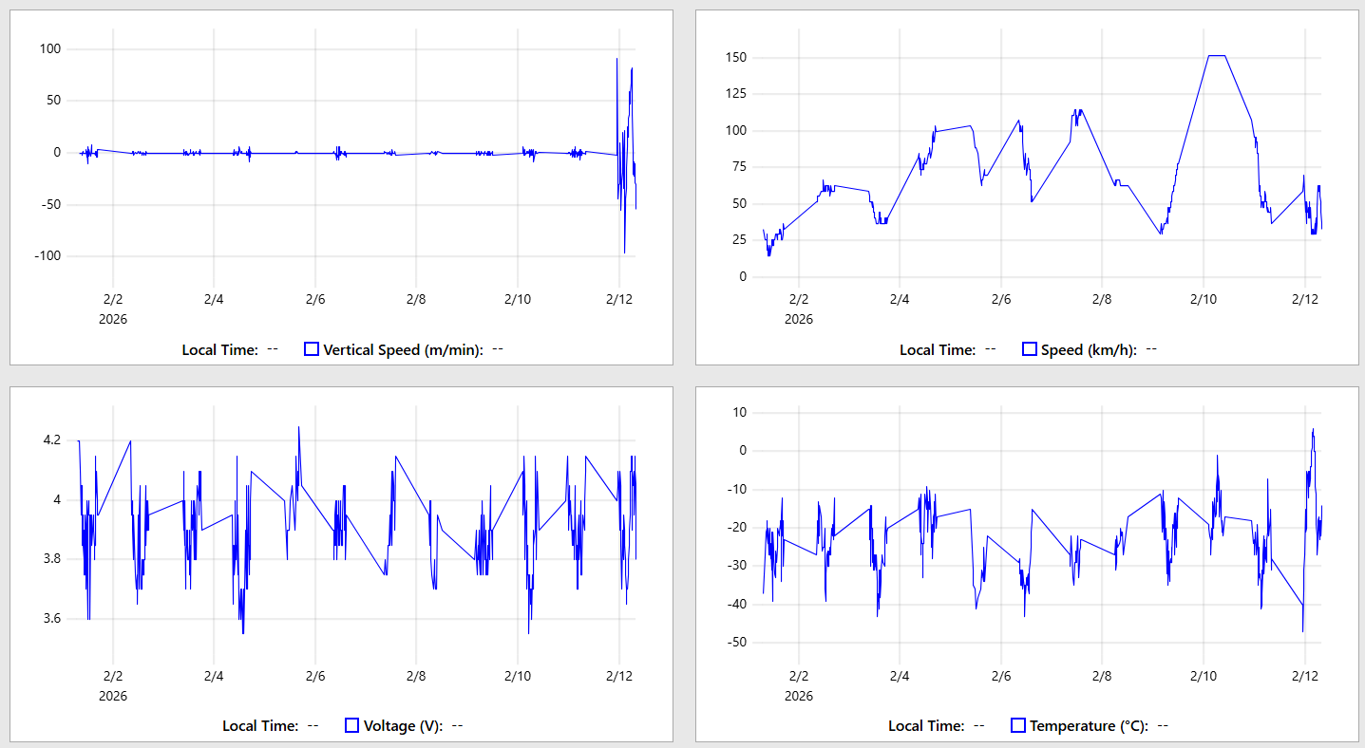

Slide 42
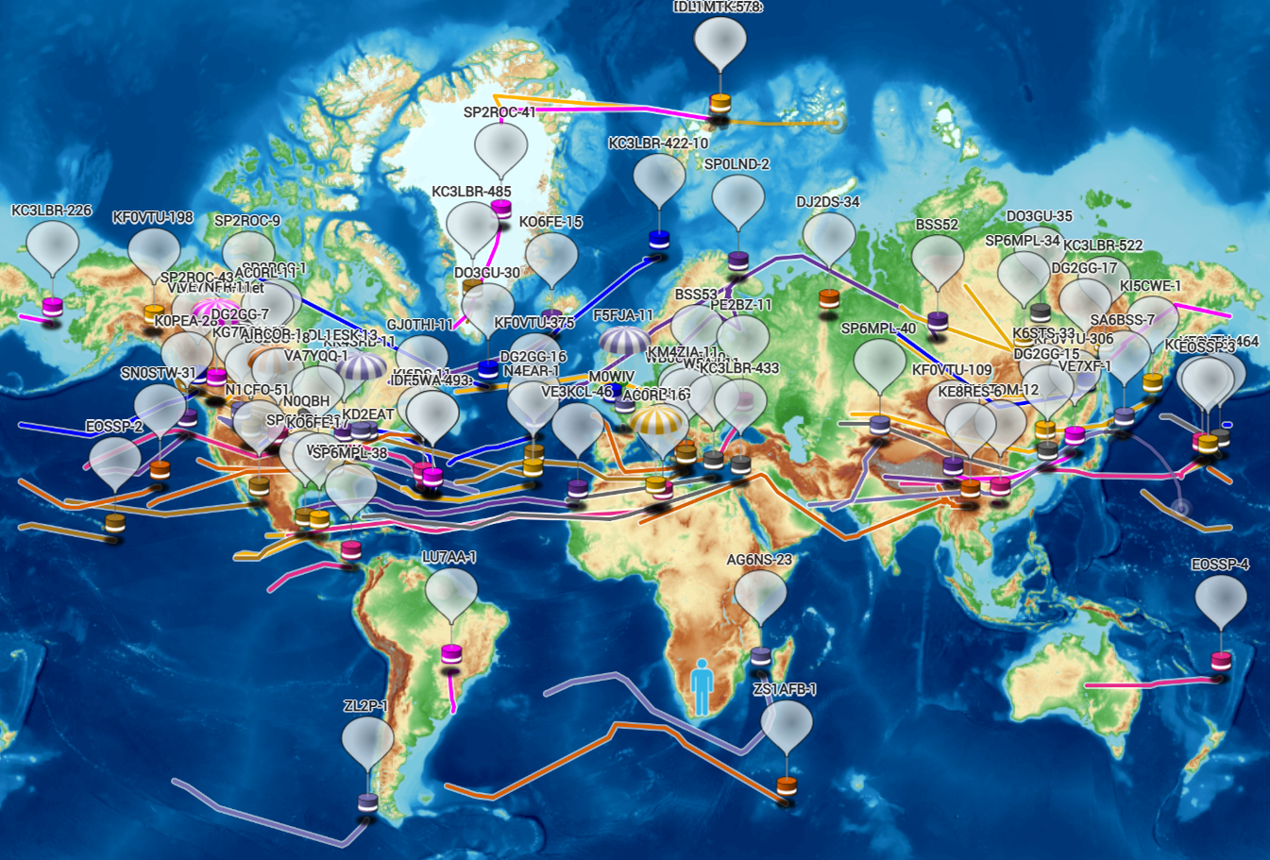
Pico Balloons World Wide
Notes:
https://amateur.sondehub.org/

Slide 43
Extended Telemetry
The standard telemetry scheme designed by Hans Summers is a fixed set of parameters encoded into a WSPR message. While effective, it has limitations:
  The telemetry layout is hard-coded
  Adding new sensors requires redesigning the encoding
  The WEB based decoders would then have to understand a specific protocol variant
To solve this, Extended Telemetry (ET) was developed. It is a more flexible system for pico balloon telemetry.
Instead of defining a fixed telemetry layout in the protocol, ET separates the system into two layers:
  Generic integer payload (ie the “Big Number”)
  External schema describing how to interpret it
The transmitted WSPR packet carries a single packed integer (encoded into Callsign, Grid and Power Level) as for standard telemetry.
The WEB decoder uses the associated schema to unpack that integer into real measurements.

Slide 44
Extended Telemetry (ET0) Header
The TX window is 10 minutes, the ET0 WSPR packet is sent in 1 of the even 2 minute slots within the 10 mins.
The Extended Telemetry contains a header defined as follows
HdrTelemetryType (1 bit): 1=U4B, 0=ET
HdrRESERVED (2 bits) = 0 (always 0)
HdrType (4 bits) = 0 (usually 0)
HdrSlot = 0,1,2,3,4
Which takes up 9.3 bits of the limited 38.5 bits available

Slide 45
HdrSlot and HdrTelemetryType
HdrSlot specifies in which 2 min TX slot of the 10 min window the telemetry will be sent.
Slot 0: Usual WSPR packet
Slot 1: Usual Std Telemetry known as U4B (by inventor Hans G0UPL)
Slot 2,3,4: available for non-std telemetry
Note: One is not forced to send the U4B packet, one can send ET telemetry in all 4 slots
HdrTelemetryType:
0 => Non Std Telemetry (can be in slots 1,2,3,4)
1 => Std Telemetry (optional) always sent in slot 1

Slide 46
Traquito and the ET0 Schema
Traquito.com website allows simple json schemas to describe ET0 telemetry that may send:-
[{ "name": "Ambient", "unit": "Celsius", "lowValue": -80, "highValue": 40, "stepSize": 1 },
{ "name": "Humidity", "unit": "Percent", "lowValue": 0, "highValue": 95, "stepSize": 5 },
{ "name": "Pressure", "unit": "MilliBars", "lowValue": 0, "highValue": 1100, "stepSize": 10 },
{ "name": "Altitude", "unit": "Meters", "lowValue": 0, "highValue": 50000,"stepSize": 50 }]
This allows custom telemetry layouts without changing the underlying WSPR transmission format.

Slide 47
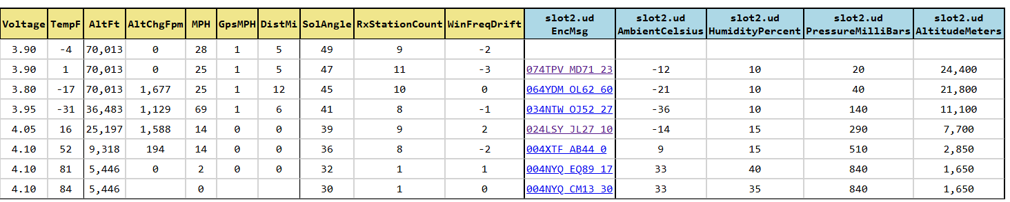
Sample ET0 decoding on Traquito
{ "name": "Ambient", "unit": "Celsius", "lowValue": -80, "highValue": 40, "stepSize": 1 },
{ "name": "Humidity", "unit": "Percent", "lowValue": 0, "highValue": 95, "stepSize": 5 },
{ "name": "Pressure", "unit": "MilliBars", "lowValue": 0, "highValue": 1100, "stepSize": 10 },
{ "name": "Altitude", "unit": "Meters", "lowValue": 0, "highValue": 50000,"stepSize": 50 }

Slide 48
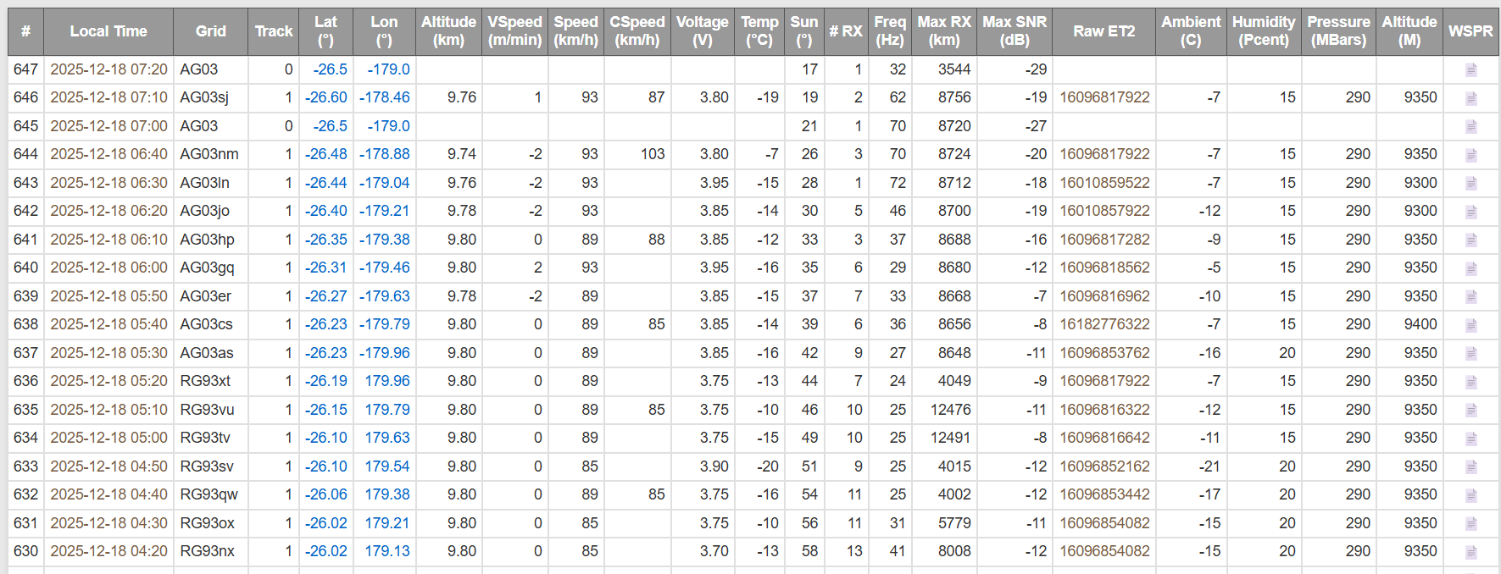
Sample ET0 decoding on wsprtv.com
https://wsprtv.com/?cs=ZS1ERZ&ch=43&band=10m&start_date=2025-12-07&end_date=2025-12-19&et_dec=et0:0,s:2_121:-80:1,20:0:5,111:0:10,1001:0:50&et_labels=Ambient,Humidity,Pressure,Altitude&et_units=C,Pcent,MBars,M

Slide 49
Generic ET or Custom Tel proposed by Andy
He proposed a simpler telemetry packet to use only
HdrTelemetryType = 0 (ET) (1 bit) - always 0
HdrSlot = 0,1,2,3,4 # 5 values (2.3 bits)
The Generic ET can store 38.5 - 3.3 => 35.2 bits
NB although formally these 2 hdr items are logically the 1st 2 fields of the Generic ET telemetry packet with the telemetry data following, before TXing the packet, HdrSlot is swapped with the data bits in the corresponding ET position so that other non-Generic ET aware systems will decode the HdrTelemetryType and HdrSlot correctly.
(Generic ET renamed to Custom Telemetry or CT)

Slide 50
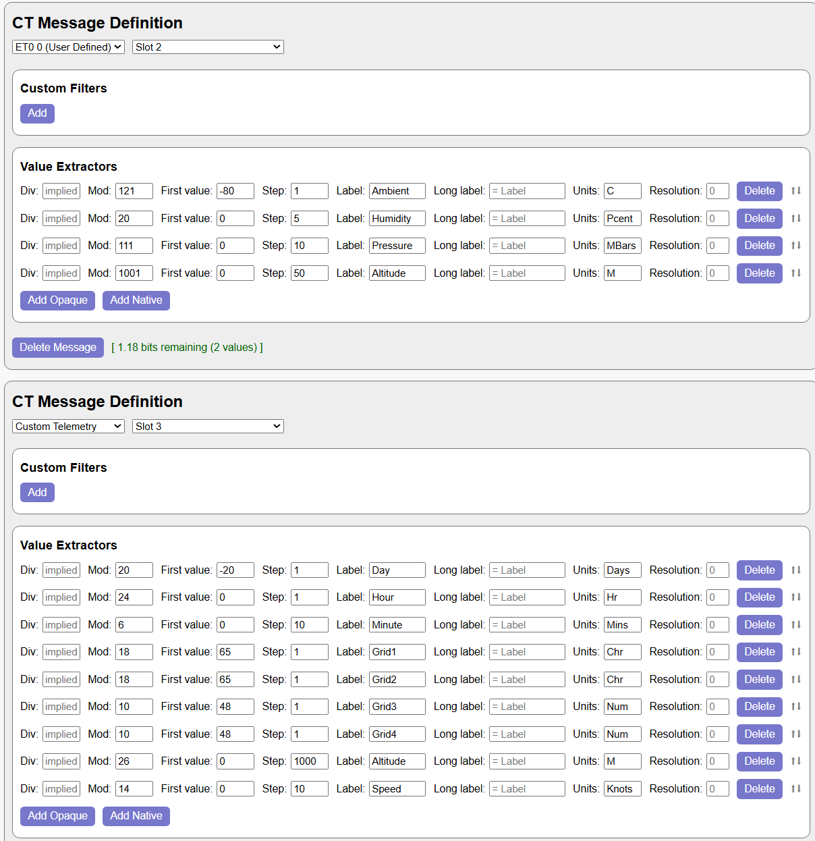
This is example shows BME280 telemetry sent in slot 2 and historical data sent in slot 3.

Slide 51
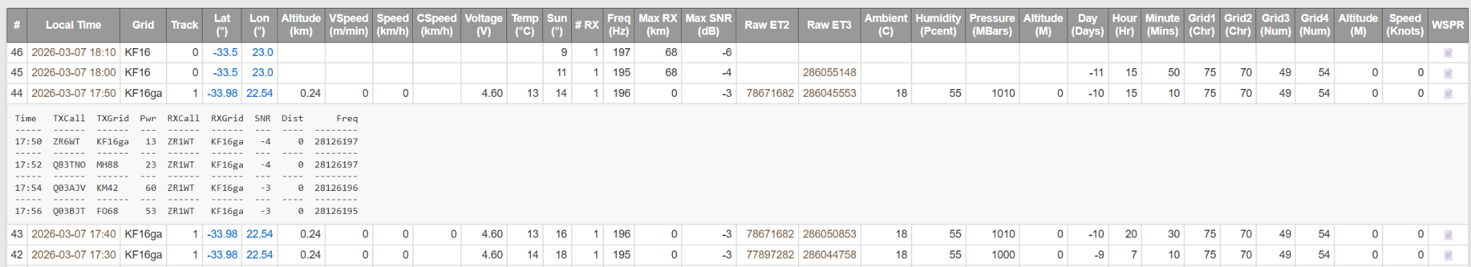
Generic ET Example
I have a flight, ZR6WT-12 (channel 463 in the 10m band) with 2 ET packets, 1 being a Generic ET packet:-
BME280 data in Slot2 (ET0) and Flight History in Slot3 (GenericET)
https://wsprtv.com?cs=ZR6WT&ch=463&band=10m&start_date=2026-02-06&end_date=2026-03-30&et_dec=et0:0,s:2_121:-80:1,20:0:5,111:0:10,1001:0:50~et,s:3_20:-20:1,24:0:1,6:0:10,18:65:1,18:65:1,10:48:1,10:48:1,26:0:1000,14:0:10&et_labels=Ambient,Humidity,Pressure,Altitude,Day,Hour,Minute,Grid1,Grid2,Grid3,Grid4,Altitude,Speed&et_units=C,Pcent,MBars,M,Days,Hr,Mins,Chr,Chr,Num,Num,M,Knots

Slide 52
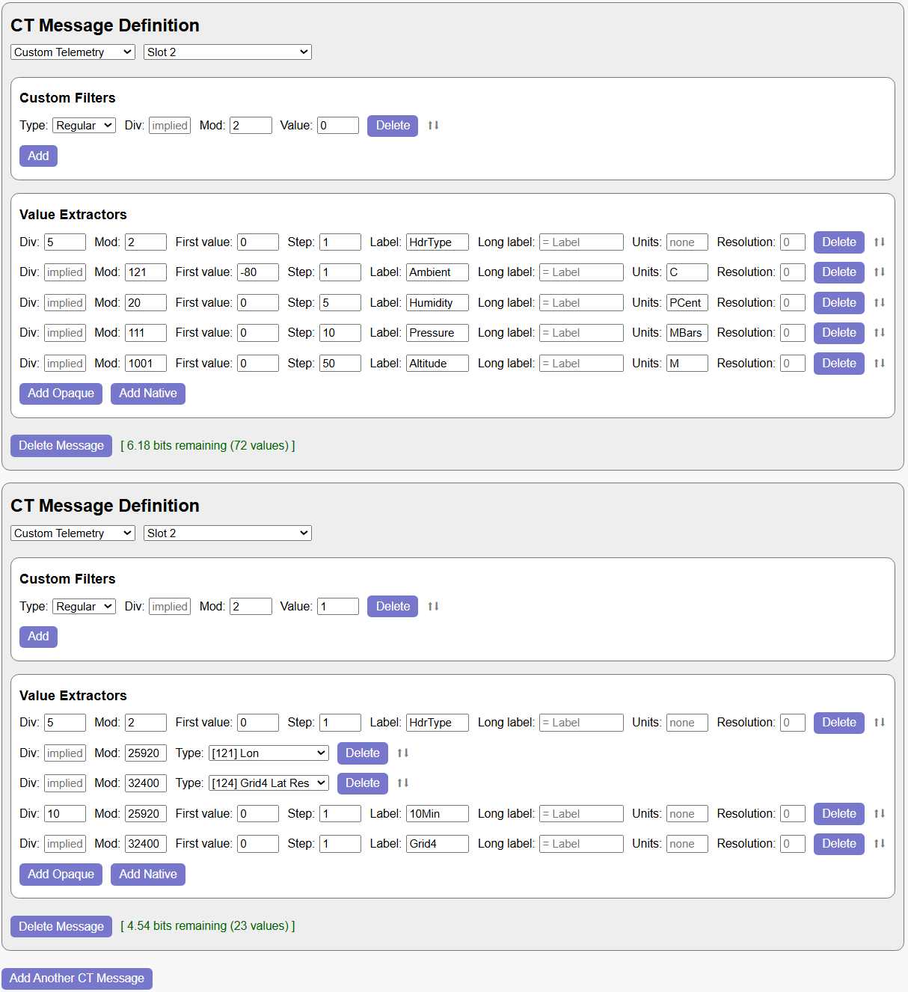
wsprtv.com goes even further. One can alternatively send more than 1 type of telemetry in a particular slot.
A filter can be specified to select the decoding to use.
So in the example on the right both have a HdrType which is either 0 or 1 to indicate the type of telemetry.
One slot type entry is BME280 telemetry
The alternate slot is historical data

Slide 53
Predicting a Flight Path
There is a very useful website that shows current and predicted wind at the various altitudes:
https://www.ventusky.com/
You will see on the next screen, a screenshot of current winds over Australia
https://www.ventusky.com/?p=-7;149;2&l=wind-200hpa

Slide 54
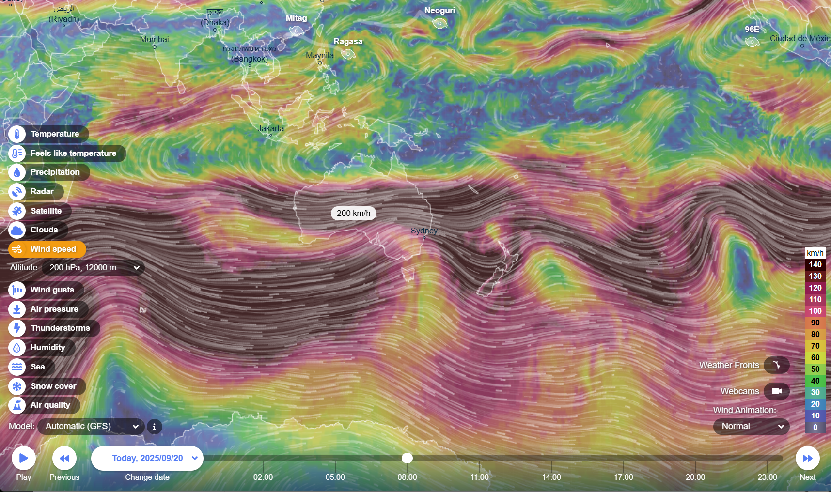

Slide 55
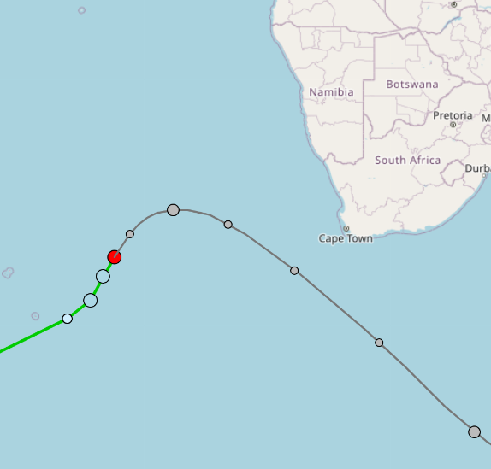
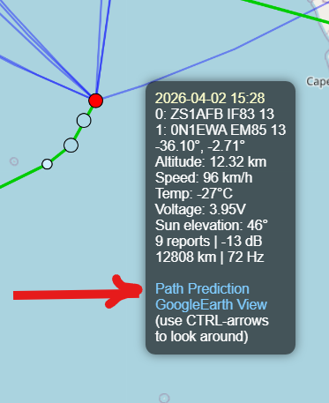
Wsprtv.com has Prediction Builtin

Slide 56
Science in Progress
What makes pico balloon science remarkable is the cost-to-science ratio. For a few hundreds of rands in parts and a ham radio licence, a hobbyist can generate months of genuine atmospheric data from the stratosphere - data that is publicly archived and can be used by researchers. The community is essentially building a distributed, citizen-operated global sensor network, filling in gaps that government weather agencies simply cannot afford to cover.
Atmospheric Wind Data
All pico balloon flights in the Pico Balloon Archive come standard with GPS location and altitude, UTC timestamps, wind speed, wind direction, and associated error measurements. This creates a continuous, global picture of upper-troposphere and lower-stratosphere wind patterns that is difficult and expensive to gather any other way.
Jet Stream & Weather Pattern Mapping
NOAA(National Oceanic and Atmospheric Administration)'s HYSPLIT(Hybrid Single-Particle Lagrangian Integrated Trajectory), model is routinely used by balloon teams to project flight paths, and the actual observed flight data in turn validates or challenges those models. Real-world balloon tracks over remote oceans and polar regions are particularly valuable, since weather balloons (radiosondes) launched by meteorological services don't cover those areas consistently.

Slide 57
Science in Progress…..
Radio Propagation Science
Every WSPR transmission is itself a data point for ionospheric science. The network of ham radio receivers picking up these signals from thousands of kilometres away feeds into our understanding of how radio waves travel through the atmosphere - data useful for telecommunications, space weather research, and HF radio planning.
Polar and High-Latitude Observations
Some pico balloons venture into the polar regions and, during the June solstice, can remain in continuous sunlight while reaching extreme latitudes deep inside the Arctic. These flights traverse some of the most data-sparse regions on Earth; their primary contribution is tracking long-duration stratospheric air movement, with additional temperature, humidity, and pressure data depending on onboard sensors.
Long-Duration Platform Experiments
Flights lasting many months allow study of:
electronics reliability in extreme cold
battery (when used) degradation in stratospheric conditions
solar cell ageing.
These conditions approximate aspects of near-space environments.

Slide 58
Science in Progress…..
A Particularly Valuable Contribution
Long-duration pico balloons are unusually good at studying stratospheric circulation stability over months, because conventional weather balloons only last ~2 hours.
This is a unique niche where amateur experiments can contribute meaningfully.
Realistic Limitations
Despite their value, pico balloon measurements have important constraints: sensor calibration is often poor, payload orientation can introduce bias (e.g., solar heating effects), altitude is not tightly controlled, and measurement standards are inconsistent. As a result, the data is best suited for trend observation and trajectory analysis rather than precision meteorology.

Slide 59
The End
You my contact me if further information is required on any aspects of this presentation
Stewart Clark ZR1WT
Email: Stewart.Gadget@gmail.com
🎈

