Slide 1


Why Science in
Amateur Radio is Important to Drive the Future
Nathaniel A. Frissell, Ph.D., W2NAF
Associate Professor, HamSCI Founder and Lead
Department of Physics and Engineering
The University of Scranton

Slide 2

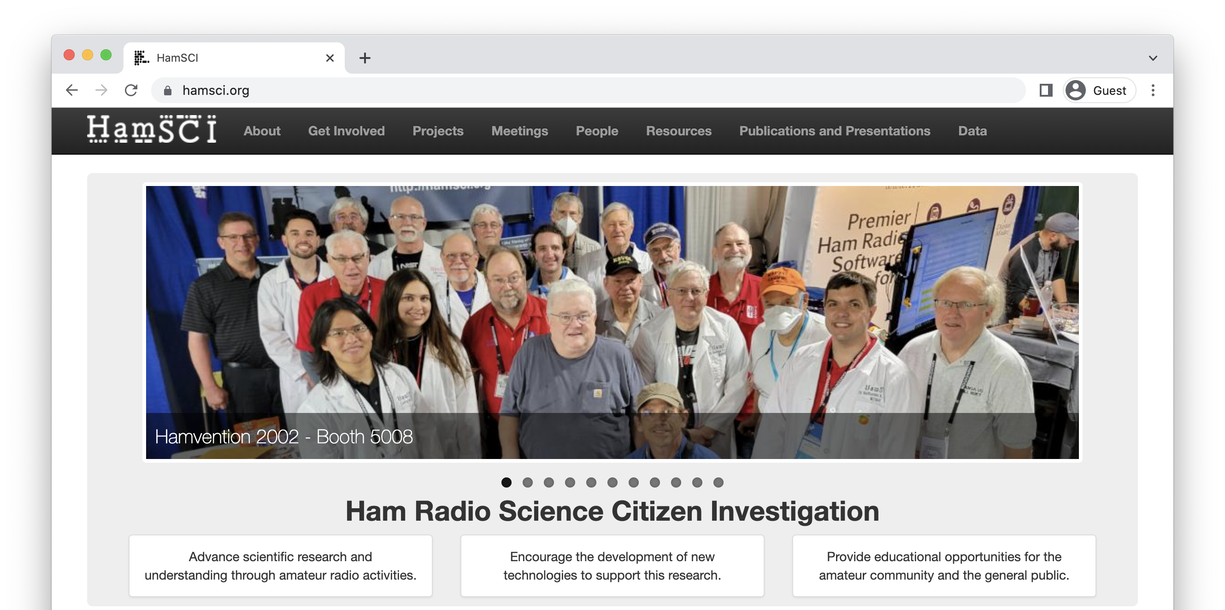



Ham radio Science Citizen Investigation
Notes:
HamSCI has the following objectives:
Advance scientific research and understanding through amateur radio activities.
Encourage the development of new technologies to support this research.
Provide educational opportunities for the amateur radio community and the general public.

Slide 3
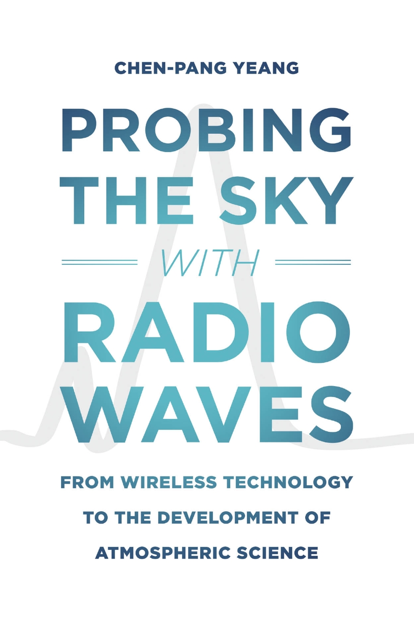
Amateur Radio Helped Discover the Ionosphere
Early amateur radio played major roles in developing the framework for large-scale citizen science & discovering the ionosphere.
Dr. Chen-Pang Yeang chronicles this in his book,
Probing the Sky with Radio Waves.
He also tells the story in his 2022 HamSCI Workshop Keynote Address, which you can watch at hamsci.org/hamsci2022

Slide 4
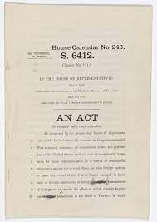
Science as a Justification for Amateur Radio
US Radio Act 1912 restricted amateur access to wavelengths shorter than 200 m.
American ham societies used experimentation to legitimate their lobbying for the amateur right to spectrum.
Today, Part 97 of the FCC rules states that a primary purpose of the amateur radio service is the “Continuation and extension of the amateur's proven ability to contribute to the advancement of the radio art.”

Slide 5
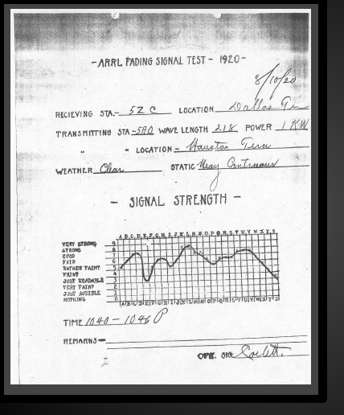
1920-21: NBS-ARRL Fading Trials
Collaboration between the US National Bureau of Standards and ARRL.
Well-structured call for the amateur radio community to submit signal reports to help understand radio signal fading.
Generated thousands of records.
Data’s scientific significance was unclear, but the campaign became a model for large-scale citizen science.

Slide 6
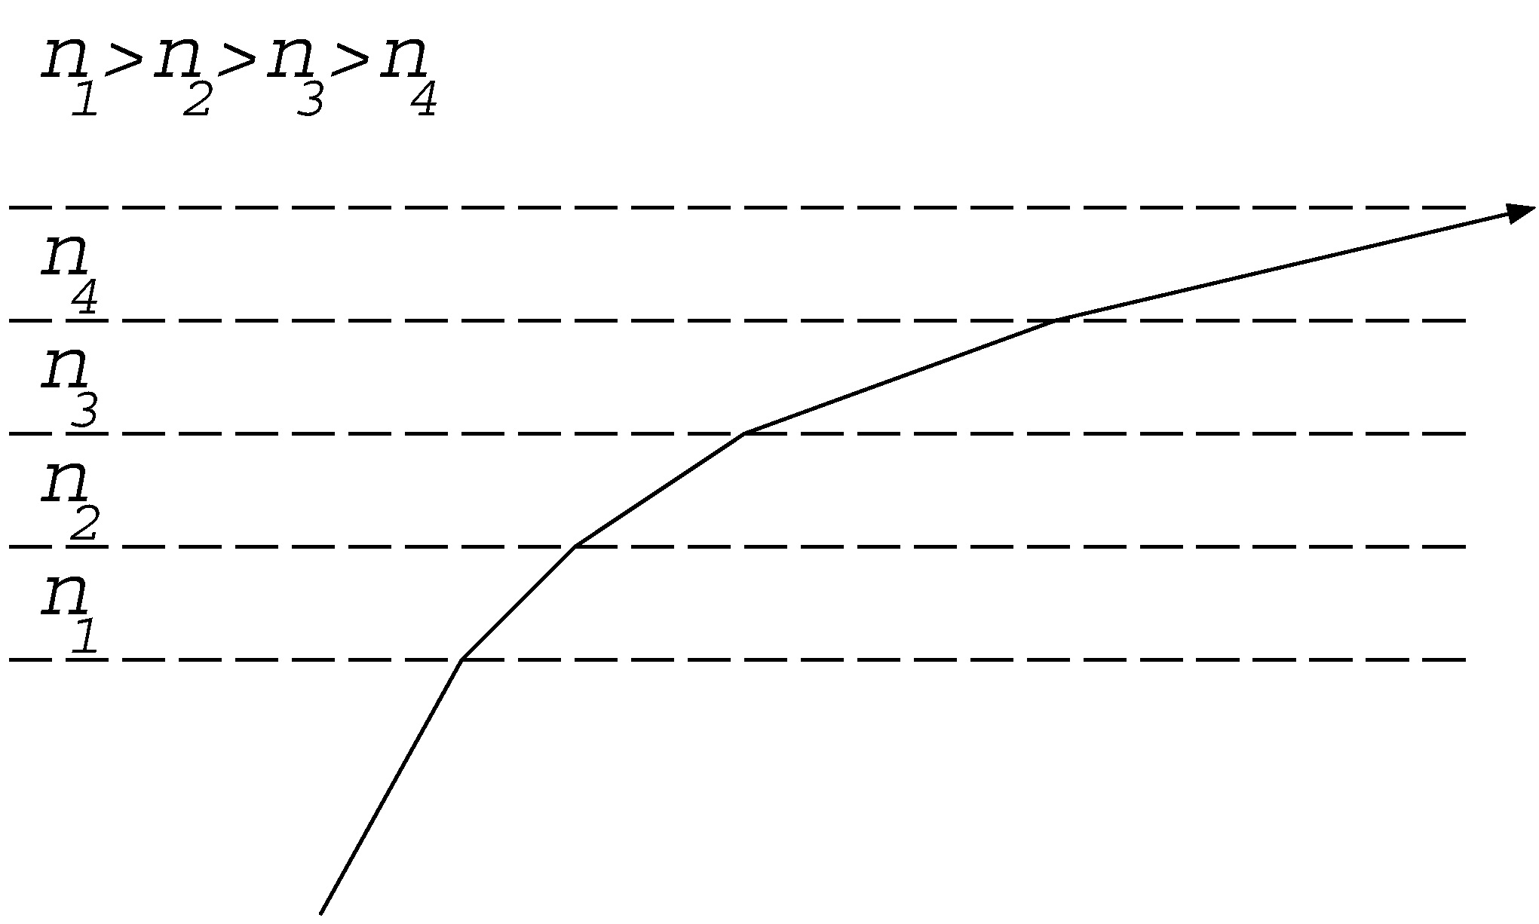
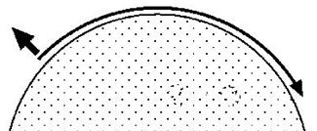
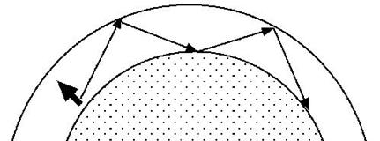
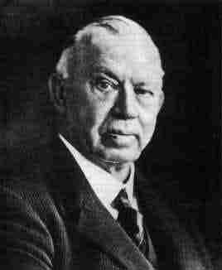
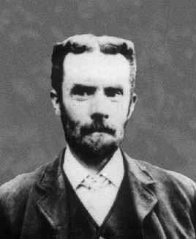
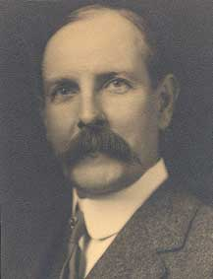
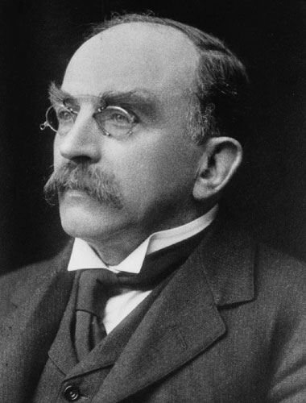
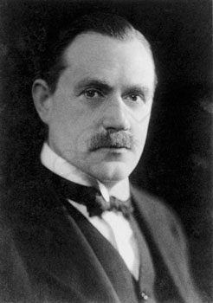
A Few Theories of Radio Wave Propagation…
Surface Diffraction Theory (1903) Hector Macdonald | Atmospheric Reflection Theory (1902) | Ionic Refraction Theory (1912-24)
Oliver Heaviside
(London)
Arthur Kennelly
(Boston)
Joseph Larmor
(Cambridge)
William H. Eccles
(London)

Slide 7
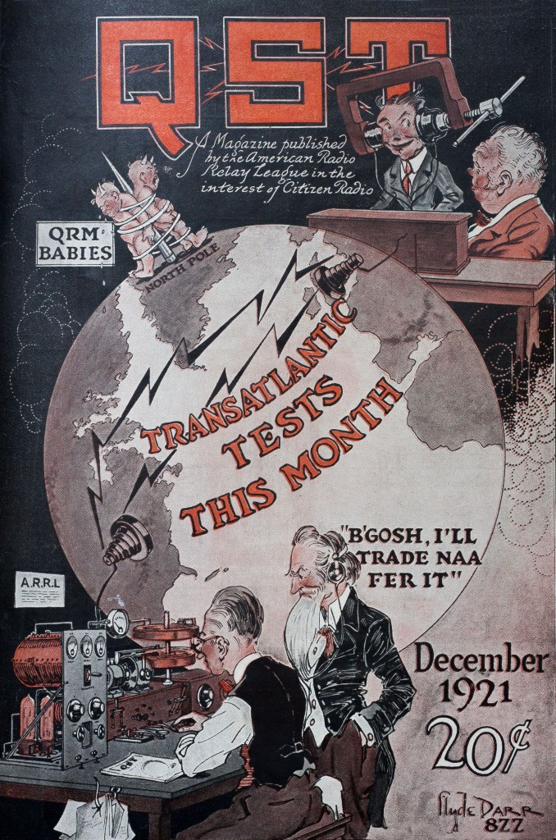
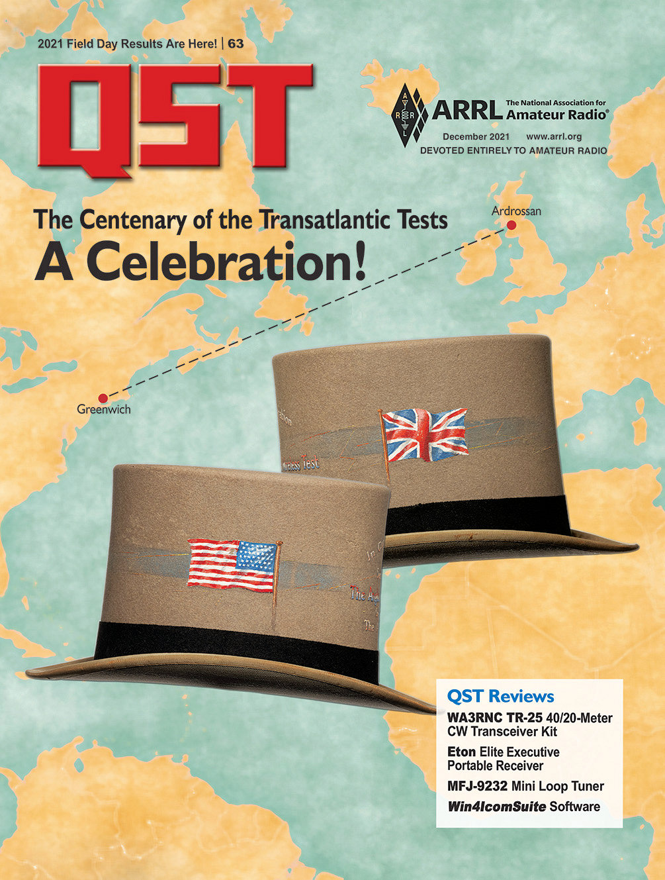
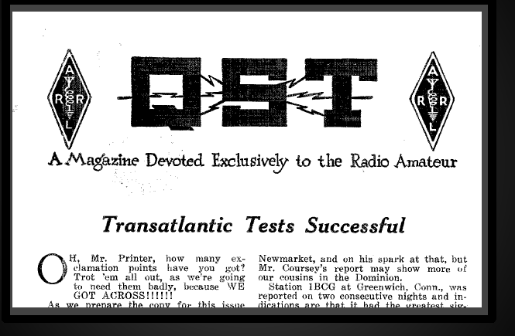
ARRL-RSGB Transatlantic Tests
A series of four Transatlantic Tests from 1921-1924 between the ARRL and RSGB:
  Provided experimental data in support of the ionic refraction theory
  Demonstrated that low-power, shortwave stations could communicate long distances, rather than requiring massive commercial transmitters.

Slide 8
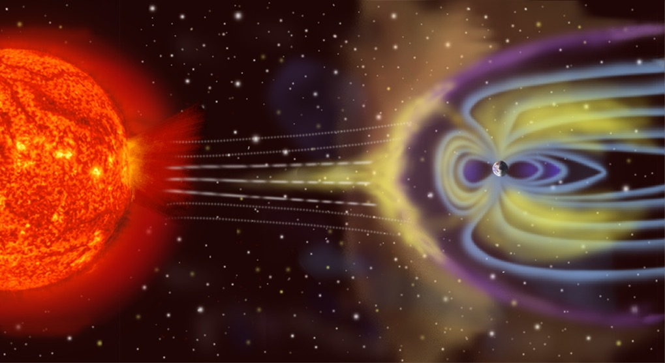
Amateur Radio Science is Unique
It is not simply that our community has made major contributions to science and engineering, but rather the way we can work is fundamentally different than what can be done in a laboratory setting.

Slide 9
Characteristics of Large-Scale Amateur Radio Science
Allows for large-scale, coordinated campaigns
Different from what is done in a laboratory
Less control, but more global view
  Global view is critical for advancing large-scale Earth and Space Science
Different perspectives
  Each person, amateur or professional, can contribute a piece to the puzzle.

Slide 10
We continue the tradition of science today…
As a global amateur radio community, we are in a better place than ever to both contribute to science and have science give back to amateur radio.
Huge thank you to Joe Taylor K1JT, Steve Franke K9AN, WSJT, WSPRNet, WSPRDaemon, PSKReporter, Reverse Beacon Network, and many, many others in the community…

Slide 11
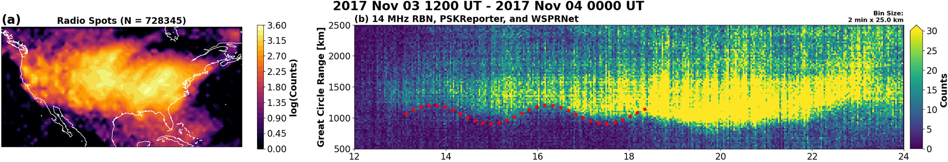
Traveling Ionospheric Disturbances
Time [UT]
(Frissell et al., 2022, https://doi.org/10.1029/2022GL097879)

Slide 12
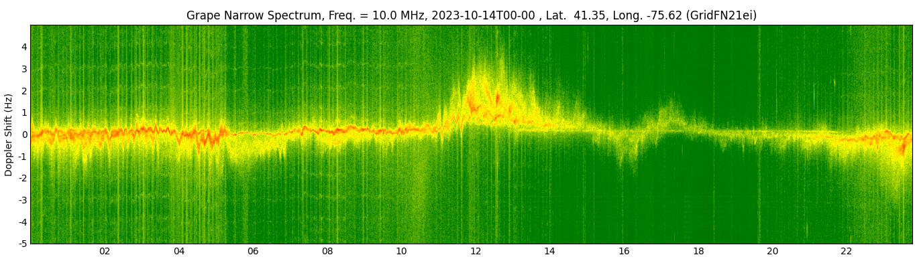
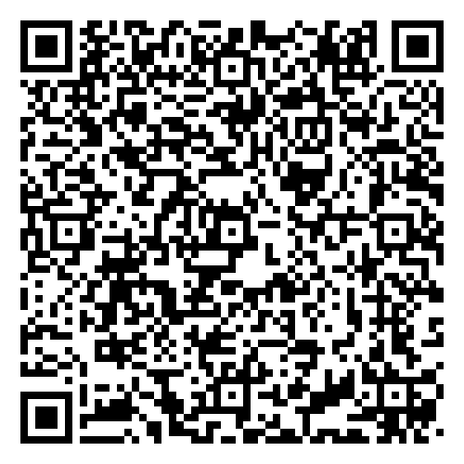
Eclipse WWV HF Doppler Observations
October 14, 2023 Annular Eclipse
W2NAF Receiver near Scranton, PA
Dawn
Eclipse
Time UTC
See all Grape1-DRF October 14, 2023 Annular Eclipse Summary Plots
https://livescranton-my.sharepoint.com/:f:/g/personal/nathaniel_frissell_scranton_edu/Eus-k84rsMtJrhL_lKHvL9EBjGxHRK752MWkM-uk-RNVQg?e=7w8Xga

Slide 13

AMSAT-SA 2026
SAST
11:00 | EME on 23cm with a solar cooker
11:45 | Telemetry via Repurposed WSPR for Amateur Radio Pico balloons as they travel around the World
12:30 | Make Meteor Scatter Communication your next Amateur Radio Project with Derek Gravett ZS5Y
13:45 | HamSCI Personal Space Weather Station & DXing Dashboard
14:45 | Technology in providing effective HAMNET emergency communication
15:15 | The SARL Noise monitoring Project

Slide 14
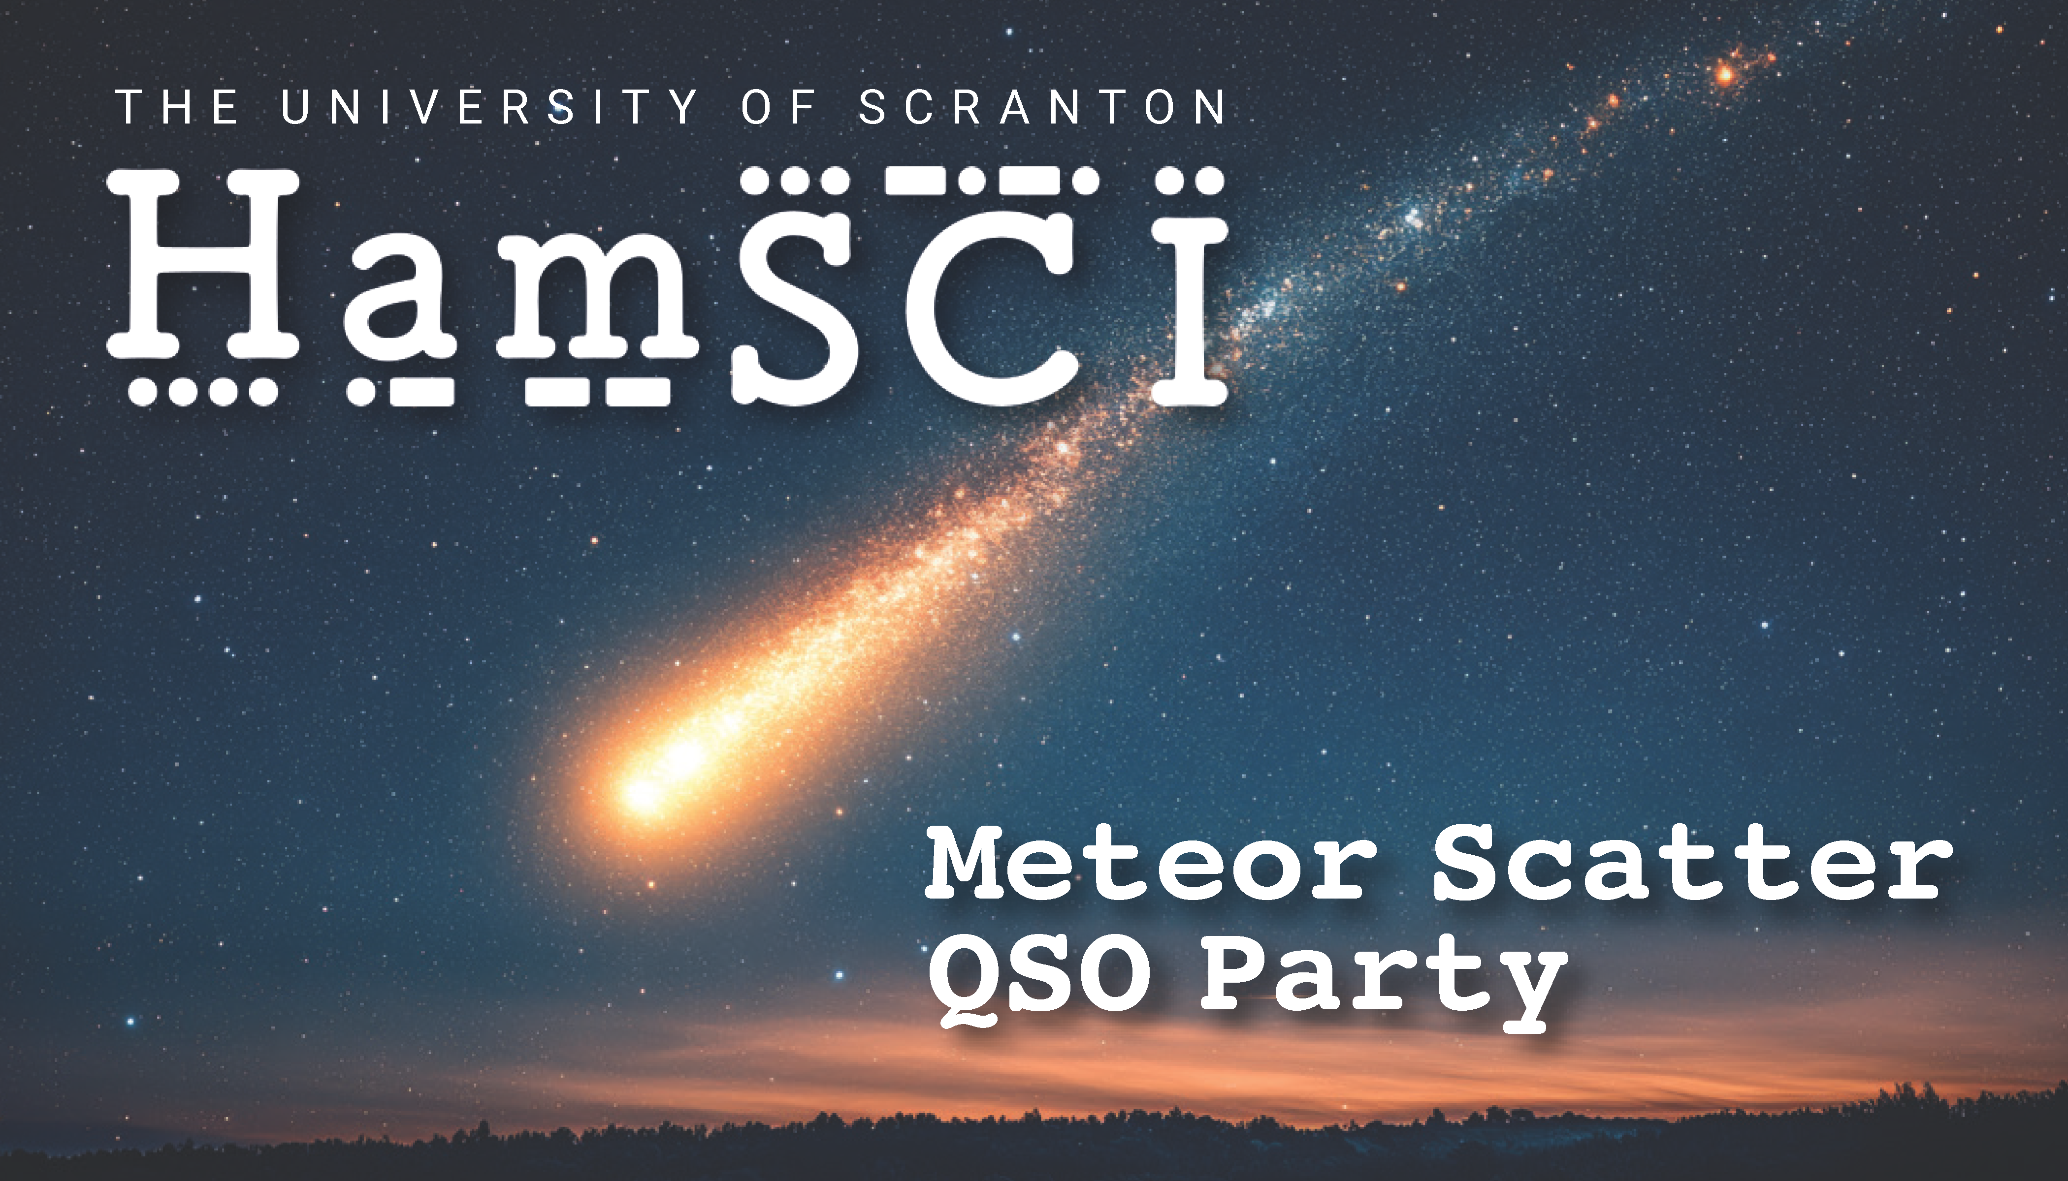
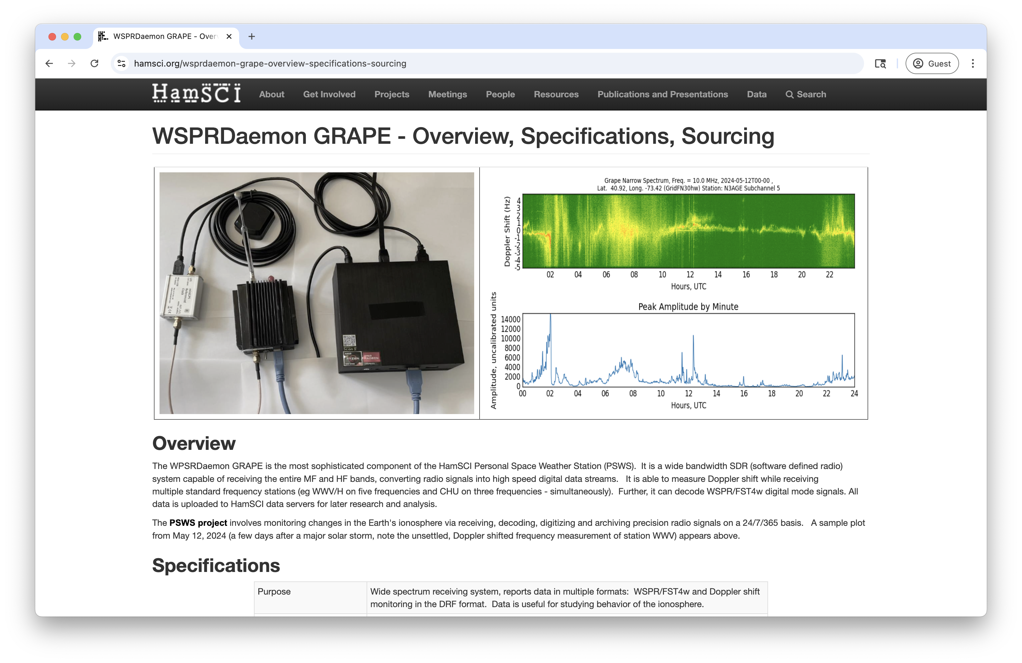
AMSAT-SA 2026 – HamSCI Synergies
SAST
11:00 | EME on 23cm with a solar cooker
11:45 | Telemetry via Repurposed WSPR for Amateur Radio Pico balloons as they travel around the World
12:30 | Make Meteor Scatter Communication your next Amateur Radio Project with Derek Gravett ZS5Y
13:45 | HamSCI Personal Space Weather Station & DXing Dashboard
14:45 | Technology in providing effective HAMNET emergency communication
15:15 | The SARL Noise monitoring Project

Slide 15
Why do we do science in ham radio?
Amateur radio science is fun and fascinating!
Science gives us purpose…
  Personal purpose to justify the time we spend doing this.
  Purpose to justify the existence of the amateur radio service.
We have unique capabilities that even large research institutions, companies, and governments cannot replicate on their own.
  Provide a platform for global measurement and collaboration
  Bring together people with unusual and unique skillsets, expertise, perspectives, and interests.
Science drives us forward. The unique needs of science forces us to refine our data and analytical skills and advance our radio engineering in directions we may not otherwise go.

Slide 16

Thank you!
We are especially grateful for the
support of NSF Grants AGS-2045755, AGS-2432821, AGS-2432822, AGS-2432824, and AGS-2432823, and NASA grants 80NSSC23K1322 and 80NSSC25K7026
support of Amateur Radio Digital Communication (ARDC).
amateur radio community volunteers who have contributed to HamSCI projects.
amateur radio community who voluntarily produced and provided the HF radio observations used in this paper, especially the operators of the Reverse Beacon Network (RBN, reversebeacon.net), the Weak Signal Propagation Reporting Network (WSPRNet, wsprnet.org),
PSKReporter (pskreporter.info) qrz.com, and hamcall.net.
use of the Free Open Source Software projects used in this analysis: Ubuntu Linux, python (van Rossum, 1995), matplotlib (Hunter, 2007), NumPy (Oliphant, 2007), SciPy (Jones et al., 2001), pandas (McKinney, 2010), xarray (Hoyer & Hamman, 2017), iPython (Pérez & Granger, 2007), and others (e.g., Millman & Aivazis, 2011).
Ann Marie Rogalcheck-Frissell KC2KRQ for the HamSCI silhouette photograph.

